Slide 1






OPERATE AND MAINTAIN A 4-WD VEHICLE IN SAFE WORKING CONDITION
D2.TTO.CL4.14
Notes:
Trainer welcomes students to class.

Slide 2
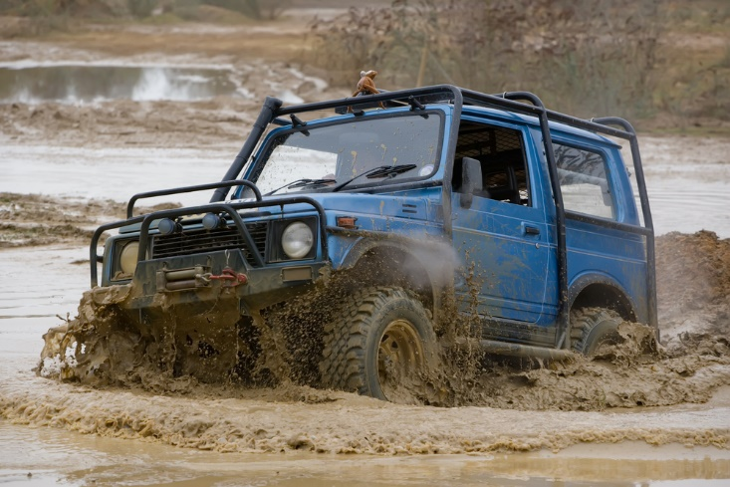
Operate and maintain a 4-WD vehicle in safe working condition
This Unit comprises four Elements:
Operate a 4-wheel drive vehicle
Recover a 4-wheel drive vehicle
Provide basic maintenance for a 4-wheel drive vehicle
Report on 4-wheel drive operations
Notes:
Trainer advises trainees this Unit comprises four Elements, as listed on the slide explaining:
Each Element comprises a number of Performance Criteria which will be identified throughout the class and explained in detail
Trainees can obtain more detail from their Trainee Manual
At times the course presents advice and information about various protocols but where their workplace requirements differ to what is presented, the workplace practices and standards, as well as policies and procedures must be observed.

Slide 3

Assessment
Assessment for this unit may include:
Oral questions
Written questions
Work projects
Workplace observation of practical skills
Practical exercises
Formal report from employer/supervisor
Notes:
Trainer advises trainees that assessment for this Unit may take several forms, all of which are aimed at verifying they have achieved competency for the Unit as required.
Trainer indicates to trainees the methods of assessment that will be applied to them for this Unit.

Slide 4

Element 1 – operate a 4-wheel drive vehicle
Performance Criteria for this Element are:
Engage 4-wheel drive correctly and when appropriate
Drive 4-wheel drive vehicle in a variety of on-road conditions and off-road conditions
Provide safety and explanatory advice to passengers
Ensure minimal environmental impact when driving a 4-wheel drive vehicle
Comply with road safety and road use rules and regulations
Notes:
Trainer identifies for trainees the Performance Criteria for this Element, as listed on the slide.
Class Activity – General Discussion
Trainer leads a general class discussion by asking questions such as:
What 4WDs have you driven?
Where?
When?
In what conditions?

Slide 5
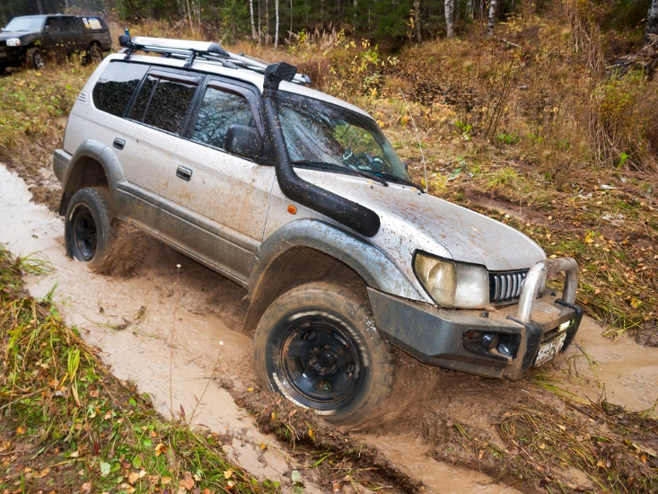
Engage 4-wheel drive correctly and when appropriate
Four-wheel drives may be:
Diesel or petrol
Standard models
Built to specifications
Configured to seat a range of passengers up to 20+
Notes:
Trainer explains a wide variety of vehicles are used for four-wheel drive touring – they can include:
Diesel or petrol powered engines – the choice of fuel is very much an individual consideration with access to fuel for re-supply a primary consideration
Personal preference is also a significant factor with many believing ‘diesel is best’ while many others believe the opposite
Standard ‘off-the-shelf’ vehicles – which:
Are produced according to manufacturers’ specifications
May be bought with a wide range of options fitted from the factory
Can be optioned with after-market options to suit individual need
Vehicles produced to Tour Operator specifications – which means they are specially configured
For identified touring conditions
To accommodate the experience the Operator has built up over the years
A range of configurations – including:
Small capacity vehicles (cars, SUVs, utilities, wagons, motor homes) accommodating four to five people
Multi-seat units (people movers, troop carriers) with space for seven to 12 people
Large or small coaches which can seat 20 plus.
Classroom Activity – Internet research
Trainer supervises internet research on relevant websites such as:
http://www.outbackcrossing.com.au/FourWheelDrive/Petrol_or_Diesel_4WD.shtml - Petrol or diesel 4WD?
http://www.4x4australia.com.au/drive/road-tests/0808/petrol-versus-diesel/ - Petrol versus diesel.

Slide 6
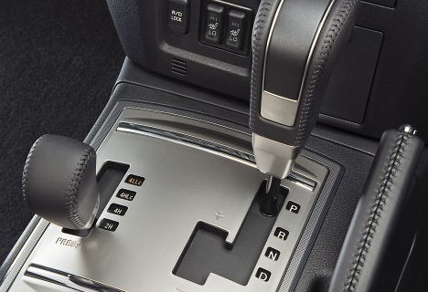
Engage 4-wheel drive correctly and when appropriate
Partial 4WD:
Is two-wheel drive when on sealed roads/under normal conditions
Becomes 4WD when the other two wheels/hubs are ‘locked in’
Generally give High and Low range options
Notes:
Trainer discusses partial 4WD:
It means the vehicle is usually a 2-wheel drive vehicle when travelling normal roads/highways but has the capacity to become a 4WD when 4WD is activated/selected
The two wheels which are not under power are known as free-wheeling hubs.
High and Low range
Part-time 4WDs generally give the driver the option of selecting ‘High’ or ‘Low’ range 4WD.
Low range provides/generates more torque at the wheels through lower gear ratios which is useful for driving difficult terrain at low speeds.
High range gives greater control and traction when driving quicker on surfaces such as compacted sand/beaches.
2WD
A vehicle that is only powered by one set of wheels (either front or rear) is known as a two-wheel drive/2WD.

Slide 7
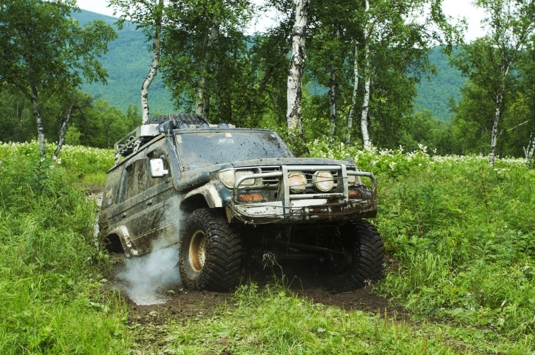
Engage 4-wheel drive correctly and when appropriate
Vehicles may also be:
AWD = permanent 4WD where vehicle is always in four-wheel drive
A4WD = where vehicle senses conditions and automatically selects/engages 4WD when necessary
Notes:
Trainer describes other 4WD vehicle options:
Permanent 4-wheel drive
A permanent 4-wheel drive vehicle is normally in 4WD mode.
There is therefore no need to engage 4WD because it is always selected.
There can be the facility to de-select 4WD and engage 2WD.
Permanent 4-wheel drives are also referred to all-wheel drive (AWD) vehicles.
Automatic four-wheel drive
This is a system where the vehicle senses different individual wheel speeds and engages 4WD automatically it detects a need to do so.
These are known as A4WDs.

Slide 8

Engage 4-wheel drive correctly and when appropriate
Terminology:
4x4 = vehicle with 4 wheels and drive to all 4 wheels
4x2 = vehicle with 4 wheels and drive to only 2 wheels
6x6 = vehicle with 6 wheels and drive to all 6 wheels
Notes:
Trainer explains terminology:
4x4 and 4x2
4x4 = a vehicle that has four wheels (the first 4) and has drive to all 4 wheels (the second 4)
4x2 = a conventional 2WD vehicle with 4 wheels and power only to two of them
6x6 = a vehicle that has six wheels and has drive to all 6 wheels.

Slide 9
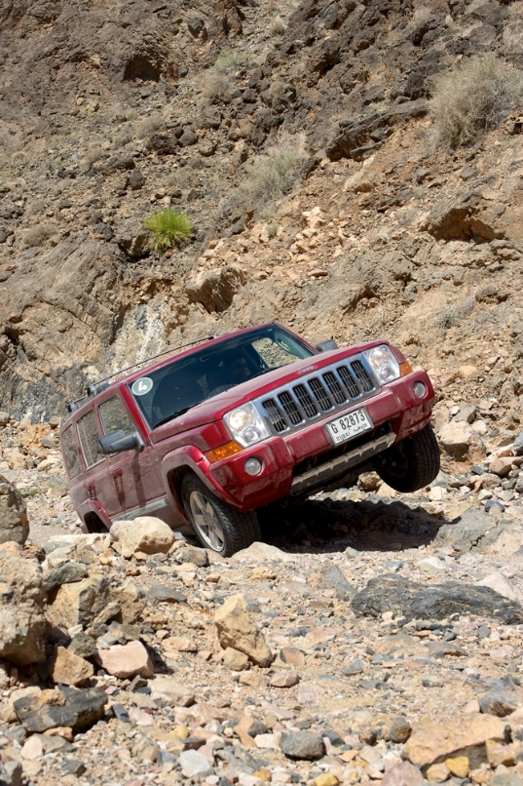
Engage 4-wheel drive correctly and when appropriate
Differentials:
Part of the drive train which transfers/converts power from the drive shaft to the wheels
Gears in the diff allow wheels on opposite sides of the vehicle to turn at different speeds
4WDs can have 2 (front and rear) or 3 diffs (centre)
(Continued)
Notes:
Trainer discusses differentials:
Background
The engine develops power which is transferred to a drive shaft.
The drive shaft is connected to the axles using a differential which transfers the power in the drive shaft to axles, and on to the wheels.
The gears in the differential allow the drive wheels on opposite sides of the vehicle to rotate at different speeds to accommodate optimum performance when turning corners or in slippery conditions.
4WD vehicles have (at least) two diffs – one for the front wheels and one for the rear wheels.
Some makes and models also have a third diff (a centre diff) which enables the front and rear drive shafts to also turn at different speeds, as well as letting each wheel rotate/drive at different speeds.
Classroom Activity (1) – Internet research
Trainer supervises internet research on relevant websites such as:
http://www.lcool.org/technical/diffs/diffs.html - Land Cruiser Owners Online: Diffs for Dummies
https://www.youtube.com/watch?v=gIGvhvOhLHU – How a differential works and types of differentials
Classroom Activity (2) – Demonstration
Trainer shows students 4WD vehicles indicating location of diffs and showing how they operate.

Slide 10

Engage 4-wheel drive correctly and when appropriate
Differentials may also feature:
Limited slip diffs
Diff locking
Notes:
Trainer presents further information on differentials:
Limited Slip Diffs
Some vehicles may be fitted with LSDs.
A LSD allows more power from the drive shaft to be sent to the wheel with the most traction in a situation where one of the wheels is slipping/spinning.
This means extra (but limited) drive can be gained from the vehicle via the wheel which is getting the most purchase on the road/track surface.
Diff locking
Diff locking is where the differential is locked so it drives both the axles (and hence both the wheels) with the same speed/power regardless of the road surface/condition.
Depending on the make/model of the 4WD it can be possible to:
Lock the front diff; Lock the rear diff; Lock the centre diff
This facility is often a benefit in certain four-wheel driving conditions as it can give much better traction, drive, control and ability to get through sand, bogs and difficult terrain.
Some vehicles (A4WDs) are fitted with automatic diff lockers meaning the vehicle senses when they are needed, and turns them on and off as required on the basis of information provided by sensors.
It is important to unlock manually applied diff locks when the difficult driving conditions are overcome and the vehicle returns to ‘normal’ use (so the wheels are able to rotate at different speeds as required when turning),
Classroom Activity (1) – Internet research
Trainer supervises internet research on relevant websites such as:
https://www.youtube.com/watch?v=WeLm7wHvdxQ – Understanding limited slip differentials
https://www.youtube.com/watch?v=RcRBYpccP6g – How diff locks work and when to use it.
Classroom Activity (2) – Demonstration
Trainer shows students 4WD vehicles demonstrating operation of:
Limited slip diff
Diff locking.

Slide 11

Engage 4-wheel drive correctly and when appropriate
Tour Operators use 4WDs because:
Customers expect them
Customers like the 4WD experience
They give customers confidence and a feeling of safety
(Continued)
Notes:
Trainer gives reasons for Tour Operators using 4WDs:
Their customers expect them to be using one
Customers like the often unique nature of an off-road 4WD experience, driving through water and mud
Four-wheel drives give customers confidence in the vehicle and the fact the tour will be a safe and trouble-free one.

Slide 12

Engage 4-wheel drive correctly and when appropriate
They give greater ground clearance and ramp-over
They allow better approach and departure angles
They handle off-road conditions better
Notes:
Trainer continues giving reasons for Tour Operators using 4WDs:
They give greater ground clearance and ramp-over angles than conventional vehicles
The allow better approach and departure angles when (for example) approaching river crossing and clearing jump-ups
They enable more dependable manoeuvrability of off-road, difficult and challenging conditions such as loose sand and mud – meaning a 4WD can take people places a conventional 2WD vehicle cannot go.

Slide 13

Engage 4-wheel drive correctly and when appropriate
Context for four-wheel driving:
Engage 4WD before it is needed
Momentum is important
Tyre pressures should often be lowered
Follow manufacturer’s instructions
There are limits to what 4WD can do
Chains may be required
Notes:
Trainer provides context relating to four-wheel driving:
Four-wheel drive needs to be selected before it is needed (see below) – based on:
Observation and analysis of the upcoming conditions of the route to be taken
Personal experience
Getting into trouble and then selecting 4WD is to be avoided – as:
It may be difficult/impossible to select 4WD when the vehicle is stuck
It may not resolve the situation
Momentum is important – four-wheel drive alone is insufficient to get a vehicle through some conditions
Tyre pressure is important in some situations – generally, lowering pressure in tyres will result in better traction through an increase in the footprint of the tread of the tyres on the surface
Vehicles should be operated strictly in accordance with any specifications provided for by the manufacturer of the vehicle as stated in the Owner/User manual
There are limits as to what a 4WD can do – they cannot ‘do anything and go anywhere’
Four-wheel drive may need to be supplemented by fitting chains to the tyres in some conditions such as snow or mud – to give added traction and control.
Classroom Activity – Guest Speaker
Trainer arranges for experienced driver of tour 4WDs to attend and:
Discuss their experience and qualifications
Explain why 4WDFs are used and how they are used
Describe benefits of tour 4WDs
Indicate limitations of vehicles.

Slide 14
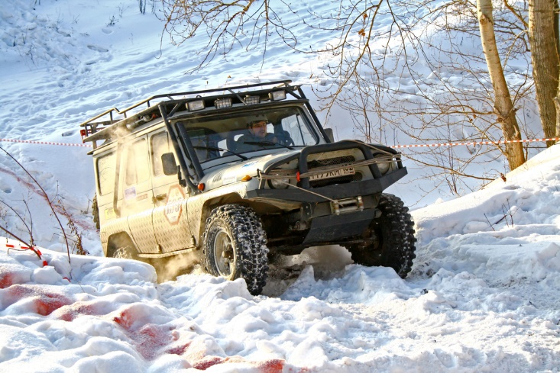
Engage 4-wheel drive correctly and when appropriate
Four-wheel drive may need to be engaged:
In muddy conditions
In rough/rocky terrain
In soft sand
In snow and ice
On steep slopes
When crossing through water
Notes:
Trainer indicates there can be a need to engage 4WD:
When tracks are muddy/boggy
If the terrain is rough and rocky
Where there is soft sand
In the event of snow and ice
Going up or down steep inclines
When crossing creeks/rivers.

Slide 15
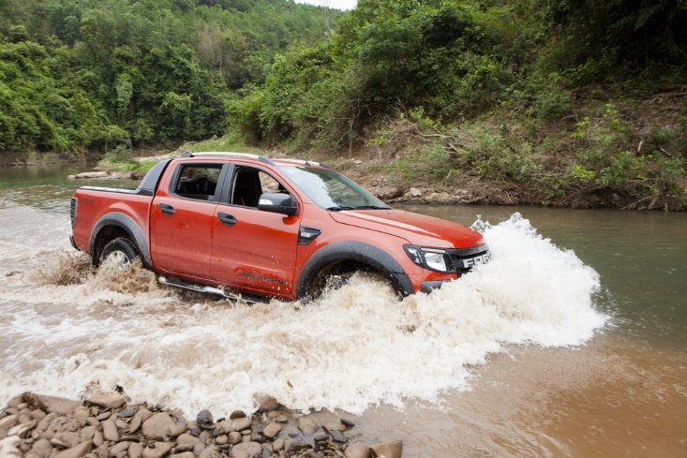
Engage 4-wheel drive correctly and when appropriate
When engaging 4WD always:
Follow manufacturer’s instructions
Set a comfortable driving position
Practice
Avoid 4WD where long, fast travel is intended
Notes:
Trainer highlights engaging four-wheel drive will vary depending on the make and model of the vehicle but always:
Follow manufacturer instructions
Create a comfortable driving/sitting position enabling full operation of all foot and hand-operated controls (knobs and pedals, levers and switches) and clear line of sight around the vehicle through windscreens, windows and mirrors
Practice the procedure before there is a need to implement it in a real-life tour situation
Refrain from engaging optional 4-wheel drive on dry, hard, flat and firm surfaces – as this increases fuel consumption and wear and tear on parts.

Slide 16
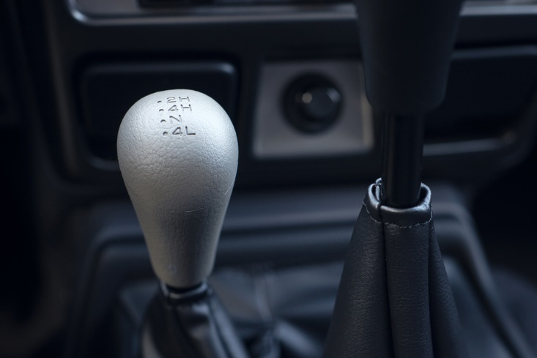
Engage 4-wheel drive correctly and when appropriate
Indicative actions when engaging 4WD may require:
Stop the vehicle
Move gear shift to neutral
Lock in hubs
Move selector to High or Low range, or
(Continued)
Notes:
Trainer presents indicative actions when engaging 4WD:
Stopping the vehicle – apart from vehicles which have ‘on the fly/move’ 4WD allowing engagement of four-wheel drive while travelling below a nominated speed
Moving gear shift to neutral
Locking in the hubs of the vehicle – by getting out of the vehicle and moving the locking hubs from the ‘Free’ position to the ‘Lock’ position
Moving 4WD selector to either High range or Low range (or Lock) – depending on conditions/torque required.

Slide 17
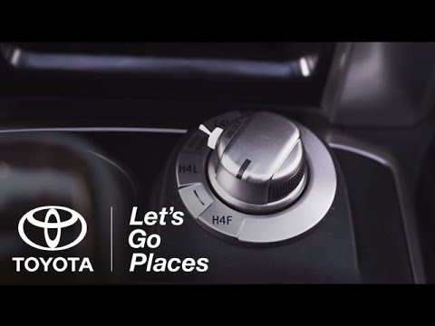
Engage 4-wheel drive correctly and when appropriate
Push a designated button on the dash, or
Move a selector knob
Select the appropriate gear for the work/travel required
Notes:
Trainer continues to present indicative actions when engaging 4WD:
Pushing a designated 4WD button on the dash
Moving a selector knob to the required position
Selecting appropriate gear.
Classroom Activity – Demonstration and Practical
Trainer demonstrates how to engage 4WD and gives students an opportunity to practice same.

Slide 18

Drive 4WD in a variety of on-road conditions and off-road conditions
Golden Keys to successful four-wheel driving:
Practice
Experience
Notes:
Trainer stresses the Golden Keys to successful four-wheel driving are the two related factors of:
Practice
Experience.
It is critical drivers of 4WD tour vehicles gain competency in driving their vehicle in all expected on- and off-road conditions before they do so in a real-life touring environment where paying passengers/tour groups are involved.

Slide 19
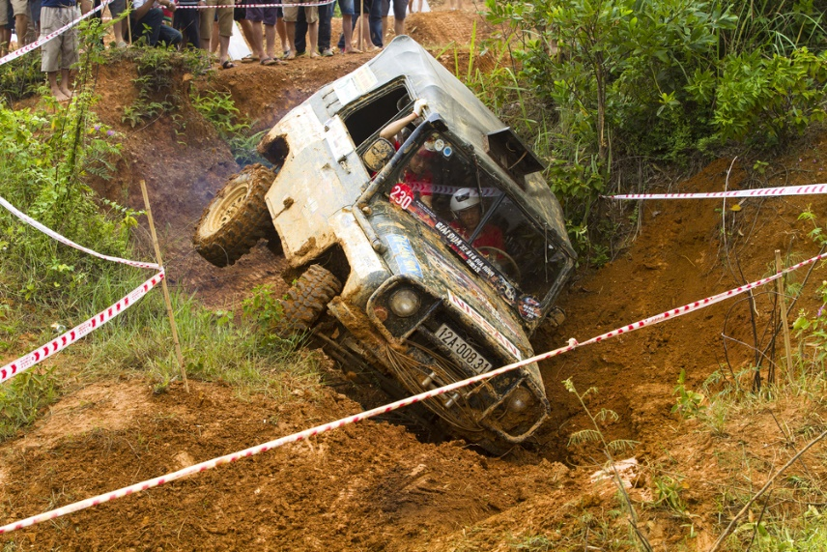
Drive 4WD in a variety of on-road conditions and off-road conditions
Basic conditions:
Off-road = terrain that is not sealed
On-road = sealed roads/highways
Notes:
Trainer describes basic road conditions:
Off-road conditions refer to terrain/ground that is not sealed or paved
On-road conditions refer to driving on sealed roads/highways.

Slide 20
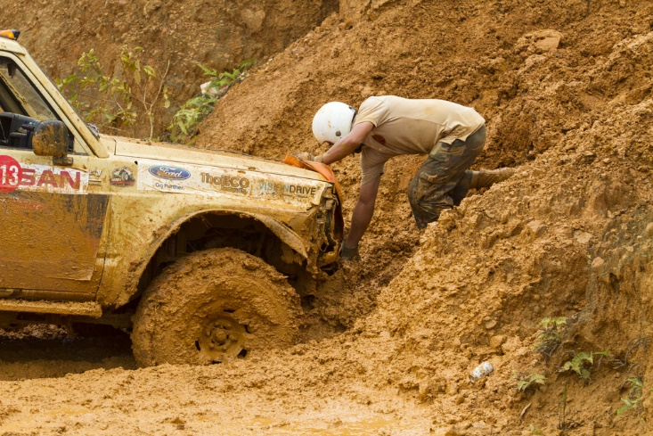
Drive 4WD in a variety of on-road conditions and off-road conditions
Driving 4WDs in on-road conditions may include driving:
In dry conditions/weather (H2)
In the wet/rain (H4)
In snow and ice (Low range)
Notes:
Trainer explains driving 4WDs in on-road conditions may include driving:
In dry conditions – where arguably most driving is done, and the standard approach is to:
Use two-wheel drive/H2 only
Leave extra distance between vehicles to allow for the extra braking distances required for heavier 4WD vehicles
Take tight corners at a lower speed due to the relatively high centre of gravity for 4WDs
Drive with headlights on at all times
In wet conditions such as when there is rain and/or ice – where speed must be reduced and High range 4WD can be used
In snow – where speed must be reduced, chains may need to be fitted and Low range may need to be selected.

Slide 21
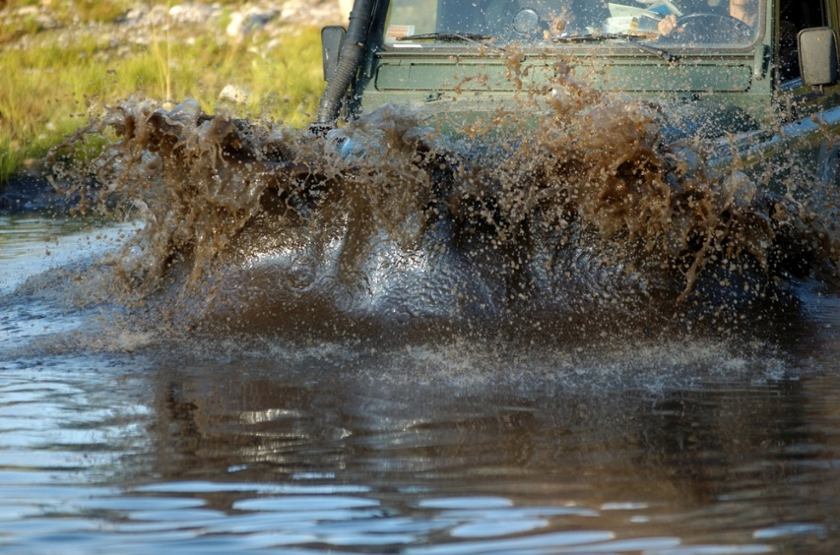
Drive 4WD in a variety of on-road conditions and off-road conditions
Off-road 4WDing may involve:
Steep inclines
Sand
Rocky terrain
Water
Soft ground
Mud
Notes:
Trainer explains operating a 4WD in off-road conditions can require/involve driving:
Steep inclines – including ascending and descending
Sand
Rocky terrain
Water crossings
Very soft ground
Mud.

Slide 22
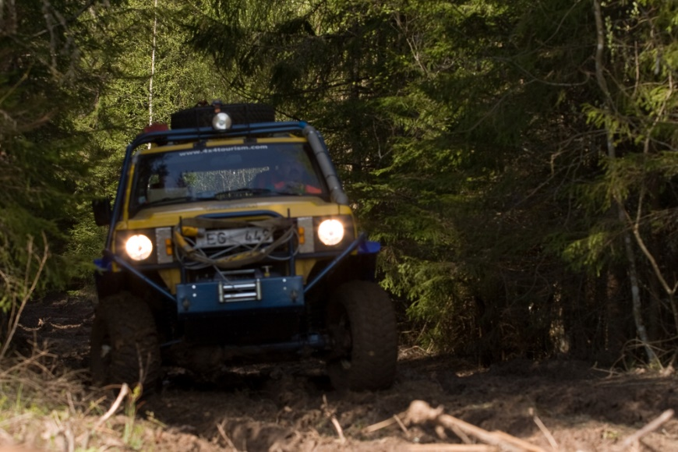
Drive 4WD in a variety of on-road conditions and off-road conditions
Before driving off-road:
Prepare the vehicle for expected conditions
Undertake basic checks
(Continued)
Notes:
Trainer gives pre-requisites before driving off-road:
Ensure the vehicle has been properly prepared for the conditions which are known to exist or which are expected on the trip – this may include:
Loading the vehicle with necessary recovery gear
Fitting protection and bash plates to the underside of the vehicle
Fitting appropriate tyres
Having tyre deflators and pumps
Having warning/sand flags
Having chains
Fitting a snorkel
Fitting a viscous fan
Fitting extended differential breathers
Undertake basic checks – to confirm:
The vehicle is fully operational – to the nest extent possible under the circumstances that apply at the time
Safety and recovery gear is available and operational.

Slide 23

Drive 4WD in a variety of on-road conditions and off-road conditions
Inspect the route
Be prepared to choose another route (or wait)
(Continued)
Notes:
Trainer continues to give pre-requisites before driving off-road:
Inspect or consider the way ahead – to:
Determine the route/path to be taken
Identify potential obstacles/problems
Make the final ‘Go’ or ‘No go’ decision
Always be prepared to, as required:
Choose or find an alternate route
Back-track and go through using another track
Wait for poor conditions (high water levels, high flow rates of rivers, deep snow) to abate/improve before proceeding.

Slide 24
Drive 4WD in a variety of on-road conditions and off-road conditions
Make passenger safety a primary consideration
Engage 4WD
Notes:
Trainer continues to give pre-requisites before driving off-road:
Consider passenger safety – which may involve:
Communicating with them to advise them of what to expect
Providing safety information
Keeping them involved and included in the tour experience
Taking controlled risks can be part of the excitement and experience of a 4WD adventure but they must never be undertaken where they pose an uncontrolled threat to people/passengers
Engage four-wheel drive – as appropriate for the individual vehicle and the nature of the route and terrain to be driven.

Slide 25
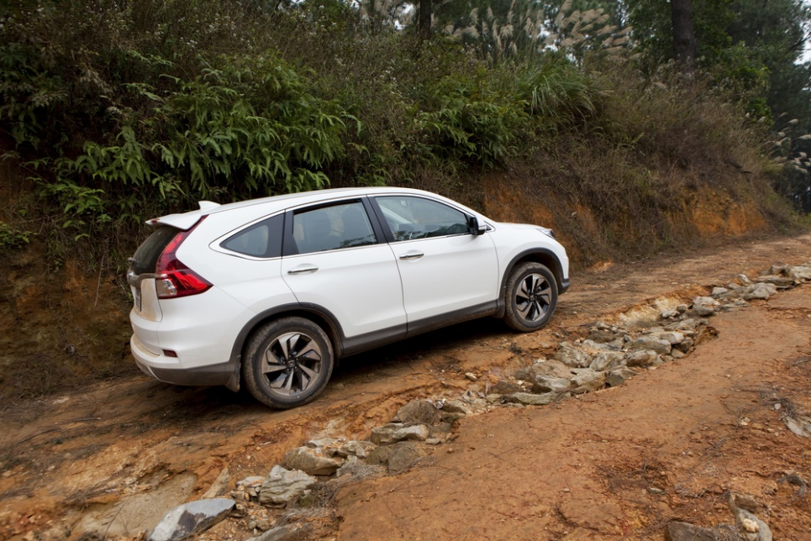
Drive 4WD in a variety of on-road conditions and off-road conditions
Ascending steep inclines:
Inspect the path/route
Engage 4WD
Engage diff locks
Turn off A/C
(Continued)
Notes:
Trainer describes procedures for ascending steep inclines:
Inspect the path – looking for:
A suitable route through/across the track which presents itself – taking into account, for example, ruts, holes, fallen trees, rocks
Surface condition – in relation to whether the ground is wet or dry and whether it is hard underfoot or soft
Approach angle – to ensure the vehicle can begin the climb and get its wheels onto the incline, and not get ‘beached’/stuck trying to make the climb
General angle/severity of the climb
Length of the incline – in terms of the distance to be covered to compete the climb
Possible recovery points that can be used – if the vehicle becomes stuck
Engage 4WD – which may require locking in hubs
Engage diff locks – if fitted and if necessary
Turn off air conditioner – to avoid inconsistent engine acceleration.

Slide 26

Drive 4WD in a variety of on-road conditions and off-road conditions
Begin climbing in a manner reflecting the slope and conditions
Stay square on
Work wheel side-to-side to get extra grip if needed
Pause at the top
Notes:
Trainer continues to describe procedures for ascending steep inclines:
Begin the climb in a manner that reflects the findings of observation of the incline – which may require, as appropriate:
Reversing and taking a run at the incline to gain momentum perhaps in H4 where the ground is solid, the length of the climb is short and the angle of incline is not too steep
Selecting Low range first or second gear and driving slowly up the incline where it is a steep incline, ground is soft sand/or the distance to be covered is significant
Stay square to the incline – climbing at an angle to the rise introduces the potential for the vehicle to roll
Work the wheel a little from side-to-side if the wheels start spinning – in order to use the tread on the sides of the tyres to gain additional purchase/traction
Pause at the top of the incline – in order to:
Check the descent – if there is one
Check for oncoming vehicles.
Classroom Activity – Demonstration and Practical
Trainer demonstrates how to climb steep incline in 4WD and gives students an opportunity to practice same.

Slide 27
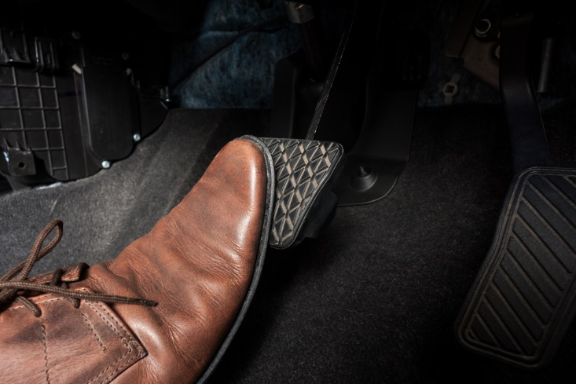
Drive 4WD in a variety of on-road conditions and off-road conditions
Stall recovery of steep ascent:
Apply foot brake
Apply handbrake
Turn ignition off
Depress clutch
Select reverse gear
(Continued)
Notes:
Trainer explains if the vehicle stalls when climbing a steep incline the procedure for a safe stall recovery is:
Apply foot brake as vehicle stalls
Apply handbrake
Turn ignition off
Depress clutch
Select reverse gear.

Slide 28
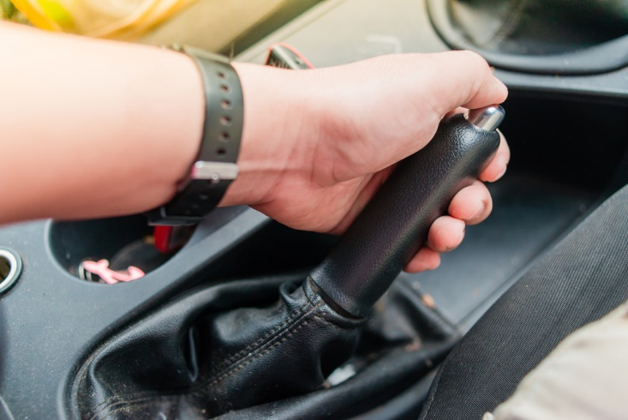
Drive 4WD in a variety of on-road conditions and off-road conditions
Release clutch
Release handbrake slowly
Turn on ignition and release brakes
Start vehicle allowing it to reverse down the slope
Apply brakes as necessary to control descent
Notes:
Trainer continues to explain ascending stall recovery:
Release clutch
Release handbrake slowly
Turn on ignition and release brakes
Start vehicle allowing it to reverse down the slope
Apply brakes as necessary to control descent.
Classroom Activity – Demonstration and Practical
Trainer demonstrates how to perform stall recovery when climbing steep incline in 4WD and gives students an opportunity to practice same.

Slide 29

Drive 4WD in a variety of on-road conditions and off-road conditions
Descending steep inclines:
Inspect the path/route
Engage 4WD
Engage diff locks
Turn off A/C
(Continued)
Notes:
Trainer describes procedures for descending steep inclines:
Inspect the path – looking for:
A suitable route through/across the track which presents itself – taking into account, for example, ruts, holes, fallen trees, rocks
Surface condition – in relation to whether the ground is wet or dry and whether it is hard underfoot or soft
Departure angle at the end of the incline – to ensure the vehicle can leave the incline and make it to level ground instead of being stuck half-way between the incline and the flat ground
Length of the descent – in terms of the distance to be covered to compete the descent
General angle/severity of the descent
Possible run-off points (into banks, bushes, trees) – in case the descent becomes out-of-control
Engage 4WD – which may require locking in hubs
Engage diff locks – if fitted and if necessary
Turn off air conditioner – to avoid inconsistent engine acceleration.

Slide 30

Drive 4WD in a variety of on-road conditions and off-road conditions
Begin descent to reflect conditions
Select Low range, first gear
Allow vehicle to creep forward
Minimise braking – let engine do the braking
Keep wheels straight/pointing forward
Stay square on
Notes:
Trainer continues to describe procedures for descending steep inclines:
Begin travel in a manner that reflects the findings of observation of the descent – which may include:
Selecting Low range first gear
Allowing vehicle to creep forward under its own power without using the accelerator – letting the engine act as a brake
Applying extra braking as required using either foot brake or hand brake – to keep a safe speed
Minimising use of brake – allowing engine to do the braking
Avoiding locking of wheels – the wheels must continue to rotate in order to retain control/steering
Keeping wheels pointing forward
Stay square on to the incline – to avoid potential for roll-over.
Classroom Activity – Demonstration and Practical
Trainer demonstrates how to descend steep incline in 4WD and gives students an opportunity to practice same.

Slide 31
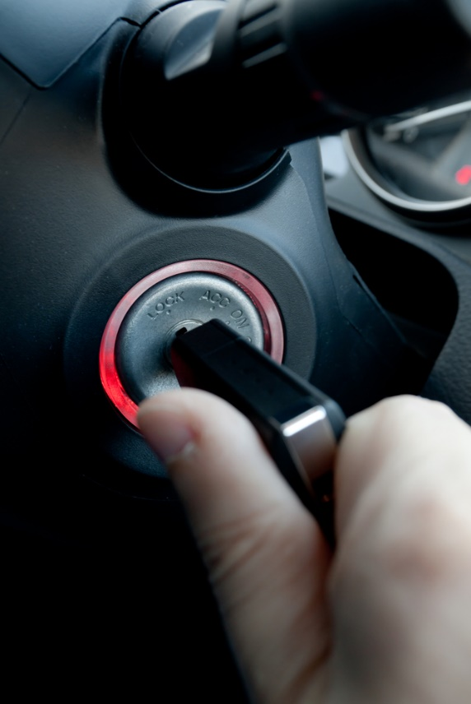
Drive 4WD in a variety of on-road conditions and off-road conditions
Stall recovery of steep descent:
Turn ignition off
Apply foot brake
Engage handbrake
Depress clutch
Select low gear
Release clutch
(Continued)
Notes:
Trainer explains if the vehicle stalls when descending a steep incline the procedure for a safe stall recovery is:
Turn ignition off
Apply foot brake
Engage handbrake
Depress clutch
Select low gear
Release clutch.
Classroom Activity – Internet research
Trainer supervises internet research on relevant websites such as:
http://www.4x4australia.com.au/gear/1004/4x4-steep-slopes-tips/ - 4x4 steep slope tips
http://4xoverland.com/how-do-4x4s-work/4x4-driving/ - How to drive a 4x4 off road [Steep slopes]
https://www.youtube.com/watch?v=uTW3H4WBxnY – 4WD Hill Climb Comparo
http://www.iventureclub.com.au/4x4-tips/article.html?k=Jem4UGra2DY – 4x4: Tip- Steep terrain

Slide 32

Drive 4WD in a variety of on-road conditions and off-road conditions
Slowly release handbrake
Turn ignition on
Release brakes
Start vehicle and allow to continue down the slope
Apply brakes emulating ABS as necessary to control descent
Steer into skids
Notes:
Trainer continues to explain descending stall recovery:
Slowly release handbrake
Turn ignition on
Release brakes
Start vehicle and allow to continue down the slope
Apply brakes emulating ABS as necessary to control descent
Steer into skids.
Classroom Activity – Demonstration and Practical
Trainer demonstrates how to perform stall recovery when descending steep incline in 4WD and gives students an opportunity to practice same.

Slide 33
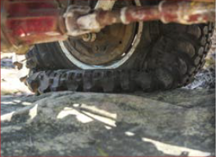
Drive 4WD in a variety of on-road conditions and off-road conditions
Preparing for soft sand 4WD driving:
Lower tyre pressure of vehicle
Lower tyre pressure of trailer
Use tyre pressure gauge
Be prepared to lower pressure a number of times
Notes:
Trainer talks about preparing for soft sand:
Lower tyre pressure of 4WD vehicle – as a starting point to increase the grip area of the tread and help keep it on top of the sand instead of sinking (or biting) into it:
Reduce by half standard on-road pressure
Reduce more for softer surfaces
Lower tyre pressure of trailer, where appropriate
Use pressure gauge to determine pressures – so there is a known reference point: write the pressures down as they are obtained and trialled
Be prepared to lower pressures further if first decrease appears insufficient – reduce by approx. two to four psi (15 – 30 kPa) each time.
Classroom Activity (1) – Internet research
Trainer supervises internet research on relevant websites such as:
http://www.offroadaussie.com/2013/02/4wd-tips-and-tricks-tyre-pressure/ - 4WD tricks and tips: tyre pressure.
Classroom Activity (2) – Demonstration and Practical
Trainer shows students how to lower tyre pressures and provides opportunity for them to do the same.

Slide 34

Drive 4WD in a variety of on-road conditions and off-road conditions
When driving on hard sand:
Lower tyre pressure slightly
Engage 4WD, High range
Decide on gear use with reference to conditions and vehicle
Travel at reduced speed
Do not contact salt water
Re-inflate tyres when sand travel is completed
Notes:
Trainer discusses driving on hard sand observing it is a bit like driving on sealed roads:
Reduce tyre pressure slightly – to increase surface area of tread that makes contact with the sand
Engage 4WD – which may require locking in hubs
Select High range
Drive off choosing gear/s appropriate to conditions, weight of vehicle, route being used and desired speed of travel
Travel at a reduced speed – that is, slower than on the open highway
Avoid contact with salt water wherever possible – to prevent potential of vehicle being damaged by rust: always wash any vehicle as soon as possible that has been contacted by salt water
Re-inflate tyres when sand driving is completed – if they have been tyre pressure was initially reduced.
Classroom Activity (1) – Internet research
Trainer supervises internet research on relevant websites such as:
http://4xoverland.com/how-do-4x4s-work/4x4-driving/ - How to drive a 4x4 off road [Sand driving]
https://www.youtube.com/watch?v=iT0Zph4h-L4 – ExpeditionOz 4WD Skills: Sand driving
Classroom Activity (2) – Demonstration and Practical
Trainer shows students how to drive on hard sand and provides opportunity for them to do the same.

Slide 35

Drive 4WD in a variety of on-road conditions and off-road conditions
When driving on soft sand:
Lower tyre pressures
Attach sand warning flags
Check/ensure recovery gear is available
Engage 4WD, Low range, 2nd gear
(Continued)
Notes:
Trainer discusses driving on soft sand:
Deflate tyres – to around 16 psi/110kPa or lower depending on sand depth/condition
Attach sand/warning flags to the vehicle if driving in areas where there are hills/dunes – to hep indicate location of the vehicle to others in the area
Check recovery gear is available – to use should the vehicle become stuck
Engage 4WD – which may require locking in hubs
Select Low range – second gear is a good starting point.
Classroom Activity – Internet research
Trainer supervises internet research on relevant websites such as:
https://www.youtube.com/watch?v=I2bA6aC4g50 – Soft sand driving
https://www.youtube.com/watch?v=KHI_cMrvsrM – 4x4: How to drive on sand tracks

Slide 36

Drive 4WD in a variety of on-road conditions and off-road conditions
Start slowly and drive slowly
Avoid sudden turns
Drive in established tracks
Be ready for less feedback through the steering wheel
(Continued)
Notes:
Trainer continues to discuss driving on soft sand:
Start slowly – to avoid wheel spin and digging in
Drive slowly but maintain momentum
Avoid sudden turns
Drive in established tracks – where the sand will be more compacted by the vehicles which have previously used that route
Be prepared for less feedback from the steering wheel – due to the depth of the sand.
Classroom Activity – Internet research
http://www.outbackcrossing.com.au/FourWheelDrive/How_To_Drive_0n_Sand.shtml - How to drive on sand
https://www.youtube.com/watch?v=lnt_D9zKjiY – Tips for beginners: Driving on sand, dunes and beaches

Slide 37

Drive 4WD in a variety of on-road conditions and off-road conditions
Approach dunes square on
Stay alert for oncoming traffic over dunes
Never assume ‘down’ side of dunes will be the same as the ‘up’ side
Be prepared to back-up and repeat a failed attempt with more momentum
Re-inflate tyres when sand travel is completed
Notes:
Trainer continues to discuss driving on soft sand:
Approach any dunes head on/square on if possible – to avoid potential for roll-over
Stay alert for oncoming traffic over the top of dunes
Never assume the drop off on the other side of a dune is the same as the climb up the dune – drop-offs on the other side can be substantially different due to wind action which may have created a sheer fall/drop away on the other side
Use the brake gently – to avoid sand building up in front of the tyres
Be prepared to reverse back over the tracks made by the vehicle if stuck – as these will be more compacted and may provide sufficient traction to develop the required traction and momentum to move forward
Re-inflate tyres when sand driving is completed – if they have been tyre pressure was initially reduced.
Classroom Activity – Demonstration and Practical
Trainer shows students how to drive on soft sand and provides opportunity for them to do the same.

Slide 38

Drive 4WD in a variety of on-road conditions and off-road conditions
When there is a need to drive rocky terrain re-consider the route is possible because it poses risks in terms of:
Uncomfortable ride for passengers
Slow travel times
Punctures
Damage to the vehicle
(Continued)
Notes:
Trainer provides base information for driving rocky terrain:
In general, rocky terrain should be avoided wherever possible as it poses lots of risks in terms of:
Uncomfortable ride for passengers
Slow travel times – which may negatively impact itinerary
Punctures
Damage to the vehicle especially the chassis and sub-structure/under-side parts of the vehicle such as diffs and fuel tanks.

Slide 39

Drive 4WD in a variety of on-road conditions and off-road conditions
When driving rocky terrain:
Inspect the route
Lower tyre pressures
Engage 4WD and diff locks
Turn off air conditioner
Begin in a manner that reflects the inspection of the route
(Continued)
Notes:
Trainer discusses driving on rocky terrain:
Inspect the path – as described previously
Reduce pressures in tyres
Engage 4WD – which may require locking in hubs
Engage diff locks – if fitted and if necessary
Turn off air conditioner – to avoid inconsistent engine acceleration
Begin in a manner that reflects the findings of observation – which may require, as appropriate:
Selecting Low range first or second gear
Driving slowly (‘crawling’) and smoothly to avoid wheel spin
Intelligently choosing the path to take to avoid traps, rocks and beaching of the vehicle.
Classroom Activity – Internet research
Trainer supervises internet research on relevant websites such as:
http://www.4-wheeling-in-western-australia.com/rock-crawling.html - Rock crawling and rocky obstacles (including viewing of all videos linked to this site)
http://www.iventureclub.com.au/4x4-tips/article.html?k=1ImWwpAqbd0 – 4x4 tip: Rocks and ruts

Slide 40

Drive 4WD in a variety of on-road conditions and off-road conditions
Be prepared to ask passengers to get out of the vehicle where there are dangerous parts
Get passengers to act as ‘spotters’
Try to stay on ‘high parts’ of the ground
Re-inflate tyres when travel is completed
Notes:
Trainer continues to discuss driving on rocky terrain:
Be prepared to ask passengers to get out of the vehicle – if patches of the route are dangerous
Be prepared to ask passengers to act as spotters – to assist with providing directions on where to position wheels
Try to stay on the high parts – straddling any ruts which may be present
Re-inflate tyres when the rocky terrain has been negotiated.
Classroom Activity (1) – Internet research
Trainer supervises internet research on relevant websites such as:
http://www.toughtoys.com.au/how-to-4x4/driving-rocky-terrain/ - Driving rocky terrain.
Classroom Activity (2) – Demonstration and Practical
Trainer shows students how to drive on rocky terrain and provides opportunity for them to do the same.

Slide 41
Drive 4WD in a variety of on-road conditions and off-road conditions
Preparing for water crossings:
Know when the vehicle will float
Know how fast the water is flowing
Know the bottom surface
Know where the air intake
Check out/walk the crossing
If in doubt – wait or avoid it
Notes:
Trainer discuses preparation for water crossings:
Know the vehicle and how deep water the water can be before the vehicle begins to float
Know how fast the water is flowing – to determine safety and work out speed required and angle of attack
Know the surface to be travelled – on the bottom of the river and on exit from the crossing
Know where the air intake is – to make sure the vehicle does not ingest water
Check-out the crossing – walk through the crossing to determine depth, identify obstacles and work out the path to be taken
Walk across the river where the left-hand wheel will go
Walk back where the right-hand wheel will go
If in doubt, avoid the crossing.

Slide 42
Drive 4WD in a variety of on-road conditions and off-road conditions
Avoid the crossing if:
Current is too fast
Water is too deep
Approach angles are too steep
Departure angle is too steep or the ground is too soft
Vehicle is not properly prepared
Notes:
Trainer issues standard cautions for water crossing saying got be prepared to avoid the crossing if:
The current is too fast
The water is too deep
The approach or departure angles are too steep
The approach or departure are too soft or otherwise too difficult
The vehicle is not/cannot be adequately prepared.

Slide 43

Drive 4WD in a variety of on-road conditions and off-road conditions
Making water crossings:
Allow motor to cool
Tie tarpaulin across front of vehicle
Loosen fan belt
Spray engine with water repellant
(Continued)
Notes:
Trainer presents driving techniques for water crossings:
Let the engine cool down first – the steps below will assist with this
Tie a tarpaulin across the front of the vehicle – to help create a bow wave
Loosen the fan belt – to prevent damage to the radiator (unless vehicle is fitted with a viscous fan)
Spray the motor with water repellent (WD-40) to help preserve the electrics.
Classroom Activity – Internet research
Trainer supervises internet research on relevant websites such as:
http://www.iventureclub.com.au/4x4-tips/article.html?k=zFA1eN-qEzg – 4x4 Tip: Water crossing
http://www.toughtoys.com.au/how-to-4x4/water-crossings/ - Water crossings

Slide 44

Drive 4WD in a variety of on-road conditions and off-road conditions
Attach recovery straps to vehicle
Lower vehicle windows
Adviser passengers to un-do seat belts
Lower tyre pressures
(Continued)
Notes:
Trainer continues to present driving techniques for water crossings:
Attach recovery straps to the vehicle – in case there is a need to recover the vehicle from the middle of the river: make sure these straps are secured above the water line
Lower windows – as a safety factor
Advise passengers not to wear seat belts
Lower pressure in tyres – if exit is sandy/soft.
Classroom Activity – Internet research
Trainer supervises internet research on relevant websites such as:
https://www.youtube.com/watch?v=wNtJNuhIf4I – ARB Water crossing techniques
http://www.outbacktravelaustralia.com.au/driving-towing-4wd-driving-skills/water-crossings - Water crossings
http://www.4-wheeling-in-western-australia.com/river-crossings.html - River crossings [including videos on this page]

Slide 45

Drive 4WD in a variety of on-road conditions and off-road conditions
Select 4WFD, Low range – 1st or 2nd gear
Lock the diffs
Enter at slow to moderate speed
(Continued)
Notes:
Trainer continues to present driving techniques for water crossings:
Select 4WD, low range – first or second gear depending on type and size of engine
Lock the diffs
Enter the water at a slow to moderate speed – so as to create a bow wave but not a ‘splash’ which will throw water up and over the bonnet/vehicle.
Classroom Activity – Internet research
Trainer supervises internet research on relevant websites such as:
http://www.4wdonline.com/A/Water.html - Water crossing
http://www.pps.net.au/4wdencounter/4wdtech/water.html - 4WD Encounter Australia: River crossings.

Slide 46

Drive 4WD in a variety of on-road conditions and off-road conditions
Drive slowly and evenly
Avoid using clutch
Dry brakes after exiting
Re-inflate tyres
Notes:
Trainer continues to present driving techniques for water crossings:
Drive slowly and evenly
Avoid using the clutch – as water will enter the housing and cause damage, slippage
Dry brakes after exiting the water.
Classroom Activity – Demonstration and Practical
Trainer shows students how to drive water crossings and provides opportunity for them to do the same.

Slide 47

Drive 4WD in a variety of on-road conditions and off-road conditions
Driving through mud:
Inspect the route
Drop tyre pressure
Engage 4WD
(Continued)
Notes:
Trainer discusses driving on very soft ground/mud:
Inspecting the route – looking for:
Ruts and obstacles
Condition of the bottom under the surface mud/depth of the mud
Distance to be covered
Recovery points
Dropping tyre pressure – to around 24 psi/165kPa
Engaging 4WD.
Classroom Activity – Internet research
Trainer supervises internet research on relevant websites such as:
http://4xoverland.com/how-do-4x4s-work/4x4-driving/ - How to drive a 4x4 off road [Mud driving]
https://www.youtube.com/watch?v=O7iqHO8__R8 – Mud driving the right and wrong way

Slide 48
Drive 4WD in a variety of on-road conditions and off-road conditions
Lock diffs
Select Low range – 1st or 2nd gear
Enter at slow to moderate speed
Use/do not use ruts as appropriate to surface and terrain
(Continued)
Notes:
Trainer continues to discuss driving on very soft ground/mud:
Locking diffs
Selecting Low range – first or second gear
Entering the mud at a slow to moderate speed – avoiding excessive speed
Using or not using ruts as appropriate – sometimes it is best to drive in the ruts and sometimes it is best to avoid them, for example:
Driving in ruts (which can provide a more compacted surface and therefore increase traction) if there is sufficient clearance for the bottom of the vehicle
Straddling the ruts – where the adjacent ground is firmer and will give better traction.
Classroom Activity – Internet research
Trainer supervises internet research on relevant websites such as:
http://4xoverland.com/how-do-4x4s-work/4x4-driving/ - How to drive a 4x4 off road [Mud driving]
https://www.youtube.com/watch?v=O7iqHO8__R8 – Mud driving the right and wrong way

Slide 49

Drive 4WD in a variety of on-road conditions and off-road conditions
Maintain momentum
Spin tyres – if mud tyres are fitted
Be prepared to reverse and try again
Move steering from left-to-right
(Continued)
Notes:
Trainer continues to discuss driving on very soft ground/mud:
Maintaining momentum – by applying acceleration
Spinning tyres – where mud tyres are fitted to help clean the tread
Being prepare to stop, reverse and re-try a route if progress is halted – as this may give extra traction through the more compacted bottom surface
Moving the steering wheel left-to-right – to allow side lugs of tyres to bite the mud.
Classroom Activity – Demonstration and Practical
Trainer shows students how to very soft ground/mud and provides opportunity for them to do the same.

Slide 50

Provide safety and explanatory advice to passengers
Common law imposes Duty of Care obligations on drivers to:
Create and maintain a touring environment that does not pose a risk to people
Take action to avoid causing foreseeable harm
Avoid engaging in risky behaviour
Notes:
Trainer discusses Duty of Care noting Common law imposes an obligation on all vehicle drivers to:
Create and maintain a touring environment that does not pose a risk to people (staff, members of the public, customers)
Take action to avoid causing foreseeable harm to people/customers/tour group members or their property/belongings while they are on tour
Avoid engaging in risky behaviour or actions which will pose a threat to anyone.

Slide 51

Provide safety and explanatory advice to passengers
Practical actions to discharge Duty of Care obligations:
Vehicle is safe/roadworthy before departure
Vehicle is maintained in a safe/roadworthy condition on tour
All road rules are obeyed
Vehicles are driven in a safe and responsible manner
(Continued)
Notes:
Trainer highlights in practice this means the driver needs to/has responsibility for ensuring:
The vehicle is safe/roadworthy when the tour departs
The safety/roadworthiness of the vehicle is maintained through the trip
All road rules and speed limits are obeyed
The vehicle is driven in a safe and responsible manner.

Slide 52

Provide safety and explanatory advice to passengers
Obvious risks are avoided or controlled
Passengers are advised of risks
Passengers comply with safety requirements
Cargo is safely stowed
Notes:
Trainer continues discussing Duty of Care obligations imposed on tour drivers:
Obvious risks are avoided or controlled
Passengers are informed about potential risks/hazards
Passengers comply with safety rules
Cargo is stored/stowed appropriately – which may require:
Re-packing/re-locating items for off-road 4-wheel drive travel to attain a lower centre of gravity for the vehicle
Placing items behind physical protection barriers – or otherwise securing them to prevent injuring people or causing vehicle damage.

Slide 53

Provide safety and explanatory advice to passengers
Failure to meet ‘Duty of Care ‘ obligations can result in:
Drivers being sued
Tour Operators being sued
The awarding of ‘damages’ to anyone who is injured or who has suffered loss
Notes:
Trainer advises on consequences of failing to meet Duty of Care obligations stating if drivers of 4WDs fail to meet their Duty of Care obligations:
They may be sued by passengers/those they injure or who lose property for negligence
The Tour Operator they work may be sued for not discharging their Due Diligence obligations by properly training their drivers
The outcomes of successful civil claims for negligence are commonly the awarding of money (‘damages’) to the person who has been injured or suffered loss.

Slide 54

Provide safety and explanatory advice to passengers
Safety information may be communicated:
Verbally – at pre-tour and daily tour briefings
In written form – using handouts
By screening a safety video
Notes:
Trainer states drivers must discuss safety with passengers and this may be done:
Verbally – in terms of:
Being part of the standard tour briefing prior to departure of the tour from the Tour Operator’s office
Being mentioned at the daily tour briefing (held every morning before the tour heads off for the day) on the first day there is expectation four-wheel drive will need to be engaged
In written form – by:
Providing a handout sheet
Including vehicle/passenger safety as a heading in the standard tour advice/information provided to all passengers when they buy their tickets
Detailing safety requirements on the business website
By screening a video – showing:
Aspects of vehicle/passenger safety
Expected touring conditions
How 4WDs perform in certain conditions.
Classroom Activity – Guest Speaker
Trainer arranges for a Tour Guide/Driver to attend and:
Discuss how and when they communicate safety advice to passengers
Identify topics which are covered by safety discussions with tour group members
Provide examples of handouts and information supplied to tourists.

Slide 55

Provide safety and explanatory advice to passengers
Safety information may include advising passengers:
To use/wear seat belts
To stay inside the vehicle
To keep windows wound up when travelling through bush
To wind windows down when doing water crossing
(Continued)
Notes:
Trainer identifies safety information may include advising passengers:
To use/wear seat belts at all times – except when river/creek crossings are being undertaken
To stay completely inside the vehicle at all times when the vehicle is moving – with specific reference to ensuring arms, hands and heads are kept inside the vehicle
To keep windows wound up when travelling through bush – to prevent branches flicking people in the head as they brush against trees and bushes
To wind windows down when undertaking river/creek crossings – to facilitate easier egress from the vehicle if there is a problem.

Slide 56

Provide safety and explanatory advice to passengers
To use hand straps
To follow driver instructions
To not alter vehicle settings
To secure loose personal items
(Continued)
Notes:
Trainer continues to identify safety information may include advising passengers:
To use hand straps/holds when the vehicle is traversing uneven ground
To follow the driver’s instructions/directions at all times – fully and promptly
To refrain from altering any vehicle settings – or tampering with/touching any of the controls of the vehicle
To secure loose personal items when the vehicle is in motion – advising how and where this may be done.

Slide 57

Provide safety and explanatory advice to passengers
To not throw rubbish from vehicle
To refrain from poor/distracting behaviour
To wait until vehicle stops before getting on/off
About on-board emergence items and recovery gear
About EMPs for the tour/trip
Notes:
Trainer continues to identify safety information may include advising passengers:
To refrain from throwing items/litter from the vehicle
To refrain from behaviour that would be distracting to the driver of the vehicle
To only get in and out of the vehicle when it has come to a full stop
About on-board emergency items, first aid kits, recovery equipment, communication systems and emergency exits
About Emergency Management Plans which have been developed – to guide action in the event of an emergency or accident.
Classroom Activity – Handouts
Trainer distributes and discusses sample EMPs.

Slide 58

Ensure minimal environmental impact when driving a 4-wheel drive vehicle
4WDs may cause environmental damage by:
Disturbing local communities
Damaging/destroying flora
Causing noise pollution
(Continued)
Notes:
Trainer explains it is possible 4WDs may impact the environment in the following ways:
Disturbing local communities – and other visitors in the area
Damaging/destroying flora – which can also lead to erosion of the land
Causing noise pollution.

Slide 59

Ensure minimal environmental impact when driving a 4-wheel drive vehicle
Contaminating water
Harming soil structure
Scaring and/or injuring wildlife
Notes:
Trainer continues to identify possible environmental damage caused by 4WDs:
Contaminating fresh water sources
Harming soil structure – by compacting, dislodging it and/or causing pot-holes
Scaring, injuring or killing local wildlife.

Slide 60

Ensure minimal environmental impact when driving a 4-wheel drive vehicle
Techniques to minimise environmental damage:
Adhering to designated tracks
Assessing quality of tracks before travelling on them
Minimising the effects of noise
Ensuring required permits have been obtained
(Continued)
Notes:
Trainer presents techniques to minimise environmental damage:
Adhering to designated tracks and routes in sensitive areas, parks or other prescribed areas – as opposed to creating new tracks and driving off-road
Assessing quality of tracks or intended routes before travelling on them – and not travelling on tracks which are:
Closed
Degraded or boggy
Minimising the effects of noise – by:
Ensuring exhaust and muffler system is effective
Avoiding revving/racing engines
Staying clear of other users
Ensuring all required permits (including payment of fees), authorities and advice have been obtained – and their requirements have been understood and complied with.

Slide 61

Ensure minimal environmental impact when driving a 4-wheel drive vehicle
Abiding by local prohibitions
Being vigilant at all times
Ensuring passenger behaviour is proper
Being patient
(Continued)
Notes:
Trainer continues to present techniques to minimise environmental damage:
Abiding by local prohibitions – regarding, for example:
Entry by vehicles into nominated areas
Use of tracks under certain weather conditions
Being vigilant when preparing, planning and driving – so as to avoid causing damage to:
Property and structures
Natural habitats of animals
Natural assets
Ensuring proper behaviour of passengers – in relation to applicable Codes of conduct which may require:
They do not litter the route and areas travelled
They do not remove flora and/or fauna from the area
They do not use firearms
Being patient – and:
Not speeding
Using passing bays, where provided, rather than driving off-road and creating new tracks in order to get passed other vehicles
Taking the time to close gates which had to be opened – standard protocol is to leave all gates as they were found.

Slide 62

Ensure minimal environmental impact when driving a 4-wheel drive vehicle
Removing obstructions from tracks rather than driving around them and creating fresh tracks
Not using trees as recovery points if alternatives exist
Giving way to foot traffic and animals
(Continued)
Notes:
Trainer continues to present techniques to minimise environmental damage:
Removing obstructions on tracks – as opposed to driving round them and creating new tracks
Not using trees as winch points if a recovery is required – or using tree protectors if no other suitable point is available
Giving way to foot traffic on tracks – and allowing animals to have right of way.

Slide 63

Ensure minimal environmental impact when driving a 4-wheel drive vehicle
Driving on sand below high water marks
Adhering to weight limits
Taking care not to start fires when driving on grass
Not travelling at night
Notes:
Trainer continues to present techniques to minimise environmental damage:
Driving on beaches only on the firm sand below high water marks – so high tide will remove vehicle marks
Note: while driving below the high tide mark will reduce 4WD impact many people recommend this is not done in case the vehicle becomes stuck/breaks down in which case it may be swamped with water when the tide comes in
Adhering to weight limits for vehicles and trailers – to avoid extra depression of ruts/soil
Taking care when driving through dry grass – that the vehicle’s exhaust system does not start fires
Not travelling at night – when there is greater danger of hitting wildlife.

Slide 64

Comply with road safety and road use rules and regulations
Compliance requirements imposed on drivers include:
Be properly licensed
Carry their licence
Ensure vehicle is registered
Display/carry proof of registration
(Continued)
Notes:
Trainer explains drivers of four-wheel drive vehicles are required to:
Be properly licensed – according to:
The size of the vehicle
Type/class of vehicle
Whether it is manual or automatic
Carry their licence – and present it on demand to authorities
Ensure the vehicle is correctly registered – in accordance with:
The type/class of vehicle being used
The commercial nature of the vehicle
Display proof of registration – to demonstrate current and relevant registration.

Slide 65

Comply with road safety and road use rules and regulations
Ensure vehicle compliance with roadworthiness
Obtain and display relevant permits
Comply with road rules
(Continued)
Notes:
Trainer continues to identify obligations imposed on drivers:
Ensure the vehicle complies with roadworthy requirements – as these apply to:
Vehicle safety
Passenger safety
Obtain, display and comply with applicable special permits as/if required by local laws – for use of designated:
Parks
Tracks
Local roads
Beaches
Other routes/locations
Comply with all applicable road rules – as these apply to:
Adhering to speed limits
Obeying traffic signs
Giving right of way to pedestrians and other vehicles – and passing and over-taking
Using indicators, lights and warning and safety devices
Demonstrating consideration and tolerance for other road users.

Slide 66

Comply with road safety and road use rules and regulations
Comply with fatigue management protocols
Comply with environment protection legislation
Comply with drink-driving and drug-related requirements
Notes:
Trainer continues to identify obligations imposed on drivers:
Comply with applicable fatigue management regulations – so the driver has sufficient:
Rest/sleep
Breaks from driving
Comply with applicable environmental protection legislation – as this applies to:
Smoke emissions
Noise pollution
Comply with relevant drink-driving legislation – and does not drive contrary blood alcohol limits as these apply to:
Age of the driver
Licence status
Type/class of vehicle being driven
Comply with legislation prohibiting driving while under the influence of drugs.
Classroom Activity – Guest Speaker
Trainer arranges for official from local Transport Agency to attend and:
Discuss driver licensing and vehicle registration requirements for tour 4WDs
Explain ways in which Tour Operators and 4WD drivers can optimise compliance with obligations
Describe consequences for non-compliance
Provide assistance to enable/encourage compliance.

Slide 67

Element 2 – Recover a 4WD vehicle
Performance Criteria for this Element are:
Use a variety of techniques to recover 4-wheel drive vehicle from bogged or trapped situations
Optimise safety for passengers and protection of property
Inspect vehicle after recovery and perform necessary maintenance and repairs before proceeding
Notes:
Trainer identifies for trainees the Performance Criteria for this Element, as listed on the slide.
Class Activity – General Discussion
Trainer leads a general class discussion by asking questions such as:
What does ‘recovery of a vehicle’ mean?
What situations might give rise to the need for a recovery?
How might recoveries be undertaken?
What experience do you have with recovering vehicles?

Slide 68

Use a variety of techniques to recover 4-wheel drive vehicles
Golden Keys to successful vehicle recovery:
Practice
Experience
Notes:
Trainer identifies Golden Keys to successful recovery of four-wheel drive vehicles are the two factors identified earlier:
Practice
Experience.
It is critical drivers of 4WD tour vehicles gain competency in vehicle recovery in all expected on- and off-road conditions before they do so in a real-life touring environment where paying passengers/tour groups are involved.

Slide 69
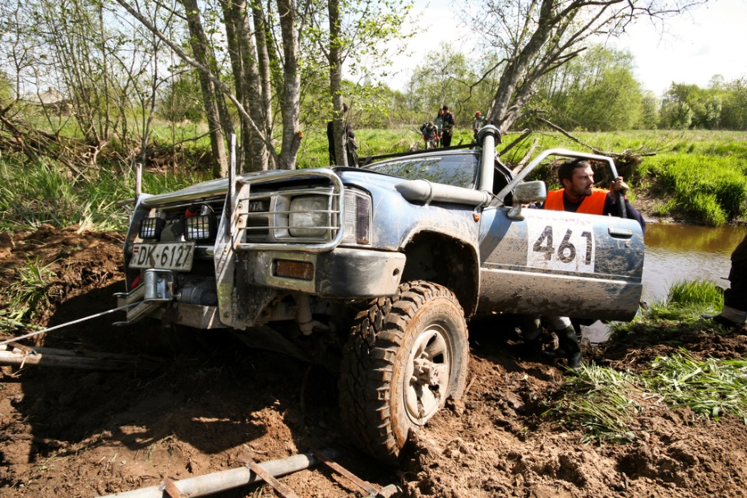
Use a variety of techniques to recover 4-wheel drive vehicles
Vehicles may need to be recovered from:
Sand
Mud
Water
Rocky terrain
Notes:
Trainer advises there can be a need to recover vehicles from situations where they have become bogged, beached or otherwise trapped:
In sand
In mud/soft ground
In water
On rocky surfaces.

Slide 70
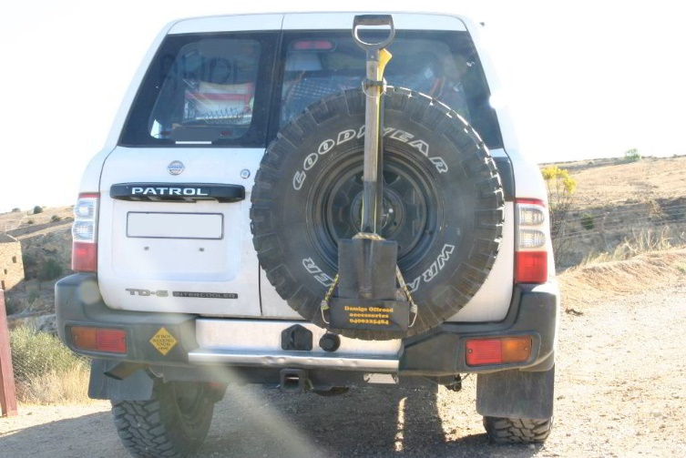
Use a variety of techniques to recover 4-wheel drive vehicles
Vehicle driver must:
Know the recovery gear provided with the vehicle
Know where in/on the vehicle the recovery gear is located
Know the mounting points on the vehicle for recovery gear
Prepare/attach recovery gear in advance
Check recovery gear for safety and readiness
Notes:
Trainer discusses recovery gear knowledge stressing vehicle driver must:
Be aware of the gear available on/in the vehicle for recovery situations
Know where the recovery gear is located
Know the recovery points/hooks and mounting features/points of the vehicle – which are connected directly to the vehicle chassis to give optimum strength
Prepare/attach any gear which is deemed necessary/possibly required for an upcoming situation
Check the gear for safety and readiness for use – especially:
Checking for frayed cables and straps
Verifying winches which have been immersed in water on previous tours have been checked and serviced
Making sure items which may be required are readily accessible.

Slide 71
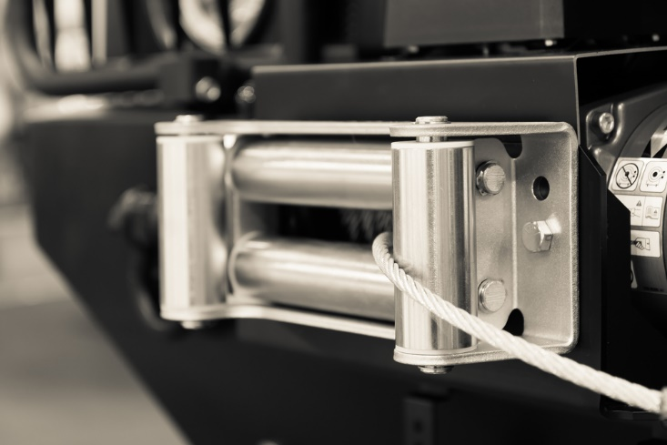
Use a variety of techniques to recover 4-wheel drive vehicles
Recovery gear must be correctly ‘rated’ so it will withstand weights to be applied during recoveries – with reference to:
Snapping breaking of items especially shackles and cables, ropes and straps
Jacks
Winches
Notes:
Trainer discusses ‘rating’ of recovery gear stating:
It is important to use recovery gear that is rated correctly for the vehicle and the recovery situation
If incorrect/insufficiently rated gear (cables, straps, mounting points, winches, jacks) is used there is danger posed through:
The snapping/breaking of items
Items being ripped off vehicles
Jacks collapsing under weight
Winches failing under load
Rating refers to the weight (in tons or tonnes) of the vehicle being recovered known as Minimum Breaking Strength (MBS)
Manufacturers may also rate their products in generic classifications such as:
Standard
Heavy Duty
Extra heavy duty.

Slide 72
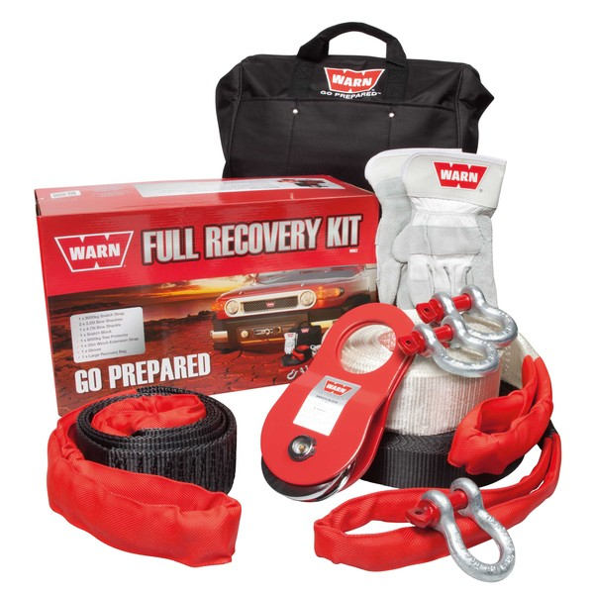
Use a variety of techniques to recover 4-wheel drive vehicles
Recovery gear might include:
Long-handled shovel
Tyre deflators
Shackles
Drag chains
(Continued)
Notes:
Trainer identifies recovery gear may include:
A shovel – traditionally a basic long-handled shovel
Tyre deflators – to lower tyre pressures before attempting to drive out of a bogged/trapped situation
Rated shackles (‘D’ shackles or ‘Bow’ shackles) appropriately rated to the weight to be handled – used to attach recovery cables/straps to vehicle mounting points and to attach snatch straps to tree protectors. Never use these to connect two snatch straps together
Drag chains – used to tow another vehicle or to remove (for example, fallen trees) from the track.
Classroom Activity (1) – Internet research
Trainer supervises internet research on relevant websites such as:
https://www.youtube.com/watch?v=CDqu3La1nls – 4WD Recovery series Part 1: The essential gear
Classroom Activity (2) – Samples
Trainer shows students examples and explains use of recovery items identified on the slide.

Slide 73
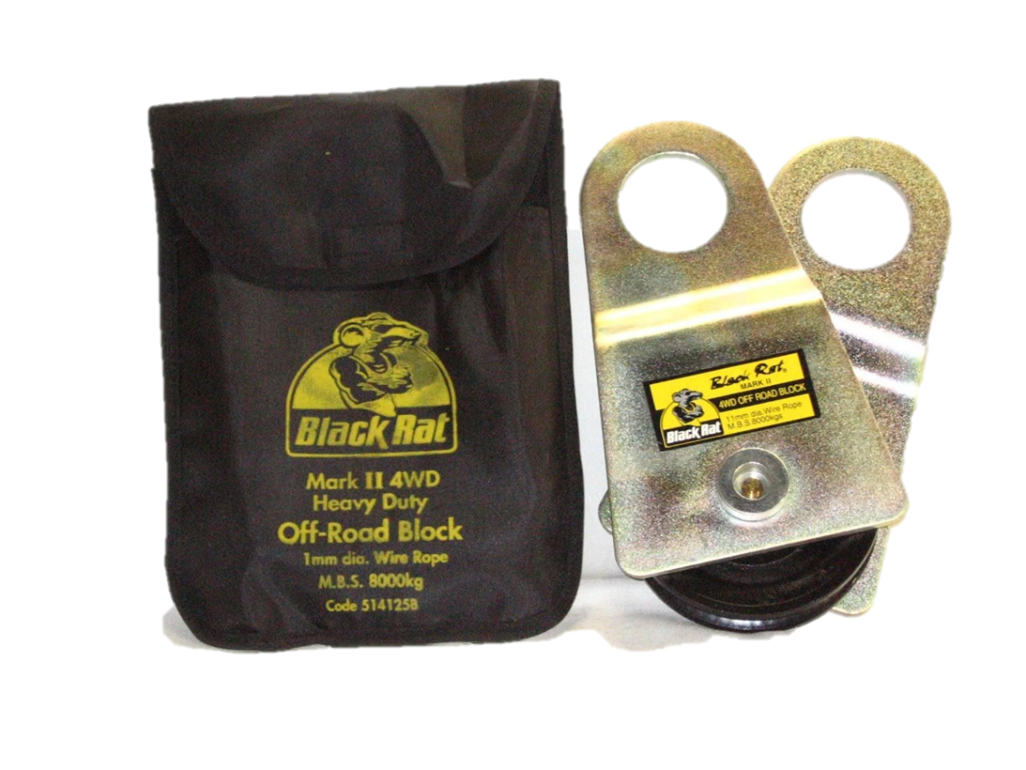
Use a variety of techniques to recover 4-wheel drive vehicles
Snatch straps
Winches
Inflatable bags
Jacks
Recovery tracks/sand ladders
(Continued)
Notes:
Trainer identifies recovery gear may include:
Snatch straps – which are used in combination with another vehicle to extricate (‘snatch’) a trapped vehicle free from sand or mud
Winches and cables – including electric winches, PTO winches, hydraulic winches, capstan (‘wheel’) winches, hand-operated winches and snatch blocks
Inflatable bags – inflated by pumps or the exhaust
Jacks – including standard scissor and bottle jacks as well as high-lift jacks (also known as ‘kangaroo jacks’)
Recovery tracks and/or sand ladders – for sand and bog recoveries as well as for bridging gaps.
Classroom Activity – Samples
Trainer shows students examples and explains use of recovery items identified on the slide.

Slide 74
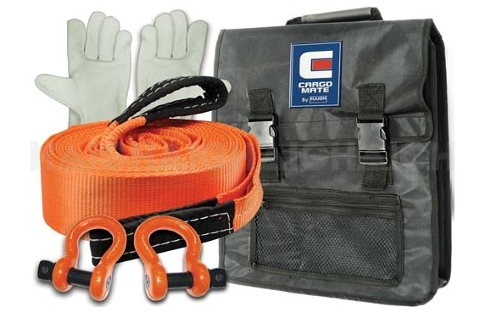
Use a variety of techniques to recover 4-wheel drive vehicles
Accessories:
Winch gloves
Winch extensions
Extension straps
Snatch strap joiners
Equaliser straps
Cable blankets/dampers
Ground anchors
Notes:
Trainer identifies recovery gear may include:
Accessories – such as:
Winch gloves – to protect hands when handing winch cables
Winch extensions – to give extra length to winch cables
Extension straps – to give extra length to snatch straps
Snatch strap joiners – to assist in the joining of snatch straps so they can be easily disconnected
Tree protectors – to wrap around tress to protect them when winching out
Equaliser straps – effectively allows snatch straps to be connected to two recovery points on the vehicle being recovered instead of just one thereby spreading the load
Recovery blankets/dampers (also known as a cable dampener) – placed over cables and snatch straps when winching or snatching to absorb energy and protect by-standers in the event a winch cable or strap breaks when under load
Ground anchors – used to help recover a vehicle where there are no natural recovery points/trees to attach a winch cable to.
Classroom Activity – Samples
Trainer shows students examples and explains use of recovery items identified on the slide.

Slide 75

Use a variety of techniques to recover 4-wheel drive vehicles
Long-handled shovels may be used for:
Digging away sand or dirt
Getting rid of debris from tracks/routes
Removing unwanted soil or material from approach and departure angles
Notes:
Trainer discusses recovery techniques:
Using long-handled shovel
The long-handled shovel is a basic recovery tool often used as a first-response when vehicles are stuck, or to even out tracks to prevent vehicles becoming trapped.
They are used for:
Digging away sand or dirt – from under the wheels of vehicles
Getting rid of debris from tracks/routes
Removing unwanted soil or material from approach and departure angles of river crossings and steep inclines.
Classroom Activity – Internet research
Trainer supervises internet research on relevant websites such as:
http://www.iventureclub.com.au/4x4-tips/article.html?k=cSwbJ7Nu3UQ 4x4: Solo recovery.

Slide 76
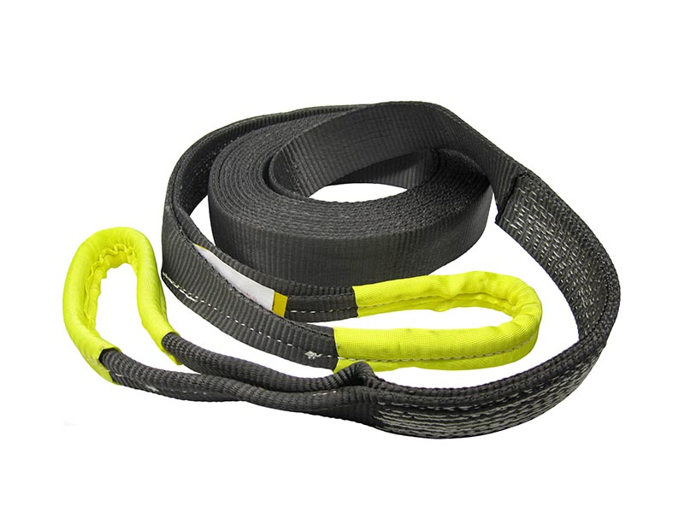
Use a variety of techniques to recover 4-wheel drive vehicles
Using a snatch strap:
Attach strap to vehicle mounting point/s
Unroll strap/s between vehicles
Add extra strap – if more length is required
Attach strap to retrieving vehicle
(Continued)
Notes:
Trainer discusses snatch strap recovery:
Attaching strap to vehicle mounting/recovery points only on both vehicles – and not to tow ball, bull bar or bumper bar
Unrolling the strap between the two vehicles making sure the strap is straight, not twisted and clear between the vehicles – and is not kinked or blocked by obstacles
Adding another snatch strap – where extra length is required between the recovery vehicle and the trapped/bogged vehicle
Attaching strap to vehicles:
Using a rated shackle – as opposed to simply looping over an attachment point
Securing to central mounting/recovery points on both vehicles.
Classroom Activity – Internet research
Trainer supervises internet research on relevant websites such as:
https://www.youtube.com/watch?v=-Ire31FrEAI – Snatch strap recovery technique
https://www.youtube.com/watch?v=bRRhfz4tdRg – Ask an expert 031: Attaching a snatch strap

Slide 77
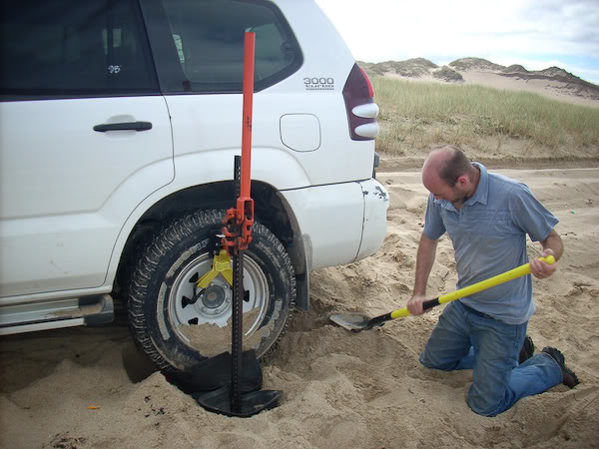
Use a variety of techniques to recover 4-wheel drive vehicles
Use shovel to remove build-up from in front of wheels
Position recovery vehicle in front of trapped vehicle
Place damping blanket over strap
Ensure comms between drivers of two vehicles
Start trapped vehicle – 4WD, Low range, first gear
(Continued)
Notes:
Trainer continues to describe snatch strap recovery:
Using long-handled shovel to remove build up in front of the wheels – in the direction the recovery will occur
Position the recovery vehicle so there is about three metres of slack in the snatch strap – to allow for a run-up to ‘snatch’ the trapped vehicle from its position
Placing recovery damper/blanket across snatch strap in the middle third part of the strap – for safety reasons
Ensuring effective communication between the recovery vehicle and the trapped vehicle – so the two drivers can coordinate their actions
Starting the trapped/vehicle and engaging 4WD, Low range, first gear.
Classroom Activity – Internet research
Trainer supervises internet research on relevant websites such as:
https://www.youtube.com/watch?v=oT6R6yTg6R0 – Mad Matt’s Snatch Strap Recovery Tips
https://www.youtube.com/watch?v=i7GSL3o1pUU – 4WDRecovery series Part 2: Snatch strap recovery technique

Slide 78

Use a variety of techniques to recover 4-wheel drive vehicles
Confirm ‘good to go’
Drive recovery vehicle forward at medium/moderate speed – 4WD, Low range, 2nd gear
Accelerate trapped vehicle to assist recovery
Repeat if necessary
Notes:
Trainer continues to describe snatch strap recovery:
Confirming between drivers their readiness to start the procedure
Driving the recovery vehicle forward at a medium/moderate rate in 4WD, Low range, second gear – as opposed to racing forward quickly at high speed
Accelerating the trapped vehicle so it can assist the recovery vehicle when the snatch strap takes effect
Realising the vehicle does not have to be recovered/freed on the first attempt – it is possible/may be necessary to repeat and repeat to free the trapped vehicle.
Classroom Activity – Demonstration and Practical
Trainer shows students how to recover a vehicle using a snatch strap and provides an opportunity for students to do the same.

Slide 79
Use a variety of techniques to recover 4-wheel drive vehicles
Using electric winch:
Always wear gloves when using winch
Follow winch manufacturer’s instructions
Unwind cable off the winch
Place tree protector around tree to be used as recovery point
(Continued)
Notes:
Trainer discusses recovery techniques:
Using electric winch
Always wear gloves
Always follow manufacturer’s instructions – especially as these apply to:
Safety issues
Operation of the winch
Use of attachments
Unwind the cable off the winch – giving sufficient length to attach to the recovery point: add extra lengths of cable if necessary
Place tree protector around the tree – and attach the winch cable with a rated shackle.
Classroom Activity – Internet research
Trainer supervises internet research on relevant websites such as:
https://www.youtube.com/watch?v=AKLtDFz5WgU – 4WDRecovery series Part 3: Basic winching techniques
https://www.youtube.com/watch?v=L2l_-3lpHII – 4WDRecovery series Part 4: Advanced winching techniques
https://www.youtube.com/watch?v=StZHlHD09XM – 4x4 The basic guide to winching techniques
https://www.youtube.com/watch?v=jatVOGInI64 – 4WD winching techniques with Pat Callinan – Ray’s Outdoor

Slide 80

Use a variety of techniques to recover 4-wheel drive vehicles
Put winch/cable dampener over cable
Take up the slack on the cable
Verify passengers are out of danger (‘Danger Zone’)
Start recovery by engaging winch
(Continued)
Notes:
Trainer continues to describe electric winch recovery:
Drape a winch dampener over the cable – as a safety precaution
Take up the slack on the cable between the tree and the trapped vehicle – guide the cable as it winds back on to the winch to ensure it rolls on evenly and smoothly
Verify passengers are out of danger
Start the recovery by engaging the winch – opinions vary and there are two basic options:
Allow the winch to do all the work and recover the vehicle on its own
Put the vehicle in 4WD Low range first or second gear and gently accelerate to assist the action of the winch.
Classroom Activity – Internet research
Trainer supervises internet research on relevant websites such as:
https://www.youtube.com/watch?v=StZHlHD09XM – The basic guide to winching techniques [for electric winches]
https://www.youtube.com/watch?v=F4mXgnll3e4 – How to winch a 4x4
https://www.youtube.com/watch?v=_4tI3HtgdCY – Reverse winch
https://www.youtube.com/watch?v=Td92wGxvujU – Snatch block in action

Slide 81

Use a variety of techniques to recover 4-wheel drive vehicles
Monitor take up of cable on spool of winch
Operate winch to preserve battery of vehicle
Use pulley/snatch blocks to assist if necessary
Notes:
Trainer continues to describe electric winch recovery:
Have person (tour crew member) monitor the take up of the cable on the winch spool/drum – to ensure an even wind on
Be aware of the heavy draw on electric power of the winch – so:
Leave engine running throughout the recovery operation
Minimise its use
Be prepared to use it in small bursts, stopping in between to run the engine and re-charge the battery
Use a pulley block at the anchor point (‘double line pull’) to assist where necessary – which will halve the load on the winch: put a dampener over both cables.
Classroom Activity (1) – Internet research
Trainer supervises internet research on relevant websites such as:
https://www.youtube.com/watch?v=JY4cKc4FKSM – Going 4WD: The Bush Winch/Wheel Winch
http://www.outbacktravelaustralia.com.au/driving-towing-recovery-techniques/safe-winching - Safe winching
https://www.youtube.com/watch?v=4TtAgDp6VKA – The intelligent winch: 4x4.
Classroom Activity (2) – Demonstration and Practical
Trainer shows students how to recover a vehicle using an electric winch and provides an opportunity for students to do the same.

Slide 82

Use a variety of techniques to recover 4-wheel drive vehicles
Alternate recovery winches include:
PTO winch
Hydraulic winch
Capstan winch
Notes:
Trainer identifies alternate recovery winches:
The PTO winch
A PTO winch is driven by engine of 4WD and operates winch drum/spool through gearbox via a power take-off.
PTO winches are also mounted at the front of the vehicle.
They are a good option where long, heavy wincing work is expected but have one major short-coming in that they cannot be used if the engine of the vehicle is dead/will not start.
The same protocols described for the use of the electric winch apply to the use of the PTO winch.
Hydraulic winch
Hydraulic winches are powered by a hydraulic motor/pump which is, in turn, powered by the engine of the vehicle.
This style of winch is not a common option but seen by many as one of the best options in that it:
Allows the same control over the winch as for an electric winch
Does not pose the same problem with flattening the battery so it can be used for extensive lengths of time
The down-side is the engine of the 4WD needs to be operational meaning it will not work if the engine cannot be started.
Capstan winch
A capstan winch features a drum/spool plus a capstan around which cable/winch rope is fed when recovering the vehicle.
The use of a capstan means vehicle recovery points can be ‘at an angle’ to the vehicle without this causing a problem.
They are generally powered off the engine of the vehicle and not via an electric motor.
Classroom Activity – Internet research
Trainer supervises internet research on relevant websites such as:
https://www.youtube.com/watch?v=xDAzHXkk3LE – PTO winches
https://www.youtube.com/watch?v=GOMZQldEctg – Red Warrior hydraulic winch with PTO power
http://www.4wdonline.com/Equip/winches.html - 4WD Online: Winches
http://www.4wdonline.com/Equip/winch-TJM.html - TJM hydraulic winch

Slide 83

Use a variety of techniques to recover 4-wheel drive vehicles
Hand-operated winches are available but not commonly used because:
They are bulky to carry
They take time to use
They have limited cable length
Notes:
Trainer discusses recovery techniques:
Hand-operated winch
Some vehicles may carry a hand-operated winch but they are uncommon as:
They are bulky to carry
Take more time to use when recovering a vehicle than other options
Are limited in the length of cable that is available for use in a recovery.

Slide 84

Use a variety of techniques to recover 4-wheel drive vehicles
Using a hand-operated winch:
Follow manufacturer’s instructions
Wear gloves
Attach cable hook to vehicle mounting point on trapped vehicle
Run out cable to recovery point
(Continued)
Notes:
Trainer describes technique for operating hand winch for vehicle recovery:
Follow manufacturer’s instructions
Wear gloves
Attach cable hook to recovery mounting on vehicle
Run out the cable to the tree which is to be used as the recovery point.
Classroom Activity – Internet research
Trainer supervises internet research on relevant websites such as:
https://www.youtube.com/watch?v=5UzX3F4Oygw – 4WD Action: 114 Terrain Tamer Hand Winch

Slide 85
Use a variety of techniques to recover 4-wheel drive vehicles
Attach tree protector
Thread cable through winch
Attach winch to tree protector with shackle
Clamp winch onto cable
(Continued)
Notes:
Trainer continues to describe technique for operating hand winch for vehicle recovery:
Attach tree protector to recovery point with rated shackle
Thread cable through the winch – setting levers in the correct position to allow the cable to be fed through the winch
Attach the winch to the tree protector using the shackle
Clamp the winch onto the cable – by moving the appropriate lever on the winch.
Classroom Activity – Internet research
Trainer supervises internet research on relevant websites such as:
https://www.youtube.com/watch?v=k39wFI4MQQg – ask an expert: hand winching

Slide 86

Use a variety of techniques to recover 4-wheel drive vehicles
Drape dampener/blanket over cable
Insert handle into winch
Pump/move handle to start the winching process
Notes:
Trainer continues to describe technique for operating hand winch for vehicle recovery:
Drape cable damper over the winch cable
Insert handle into winch
Pump/move the handle to commence the winching process.
Note: snatch blocks/pulleys can be used in combination with hand winches in the same way they can be used with other winches.
Classroom Activity (1) – Internet research
Trainer supervises internet research on relevant websites such as:
https://www.youtube.com/watch?v=MvU2g4dyKhI – Exacta hand winch
Classroom Activity (2) – Demonstration and Practical
Trainer shows students how to recover a vehicle using a hand-operated winch and provides an opportunity for students to do the same.

Slide 87

Use a variety of techniques to recover 4-wheel drive vehicles
Using hi-lift jack:
Spray with WD-40
Follow manufacturer’s instructions
Fit jack into base plate
Provide solid surface for lift – to best extent possible
(Continued)
Notes:
Trainer describes technique for using hi-lift jack for vehicle recovery:
Clean and spray with WD-40 – as these jacks are usually carried on the outside of the vehicle and become dirty
Follow manufacturer’s instructions
Fit jack into base plate – if base is separate
Provide solid surface on which to locate the base of the jack – as best as possible given the conditions.
Classroom Activity – Internet research
Trainer supervises internet research on relevant websites such as:
https://www.youtube.com/watch?v=DgjqhU5PgkE – ARB hi-lift jack demo
https://www.youtube.com/watch?v=1a_5IpDzPPI – How to use a hi-lift jack safely

Slide 88
Use a variety of techniques to recover 4-wheel drive vehicles
Flip out lift plate/bar
Position jack and fit/fix lift plate/bar to vehicle
Move selector to ‘Lift’
Insert jack handle – lift slowly keeping head out of the way
(Continued)
Notes:
Trainer continues to describe technique for using hi-lift jack for vehicle recovery:
Flip out the lift plate/bar on the jack – which will be used to take the weight when the vehicle is lifted
Locate jack as required near lifting point, which may be:
Solid part of the vehicle such as a steel bull bar
A hole/lug into which the lift bar is inserted
Adjacent to the bogged wheel – where a lift strap (‘lift mate’) can be attached to the wheel, instead of to a vehicle lift point
Move selector/lever to ‘lift’
Insert jack handle and pump to lift vehicle – taking care:
To lift slowly
To use both hands to optimise control over the handle
To not allow head to be positioned above the handle – which can kick back and cause injury to the operator
To keep the jack stable – and not allow it to topple.
Classroom Activity – Internet research
Trainer supervises internet research on relevant websites such as:
https://www.youtube.com/watch?v=hUL-l9Yi3Ws – How to use the high-lift jack

Slide 89
Use a variety of techniques to recover 4-wheel drive vehicles
Apply pressure at tip of handle for maximum leverage
Listen for ‘click’ as lift climbs
Lift vehicle clear of obstruction
Insert rocks, timber, tracks or sand ladders
Lower jack – selecting ‘Down’ and operating slowly and using both hands
Notes:
Trainer continues to describe technique for using hi-lift jack for vehicle recovery:
Apply pressure to the end of the handle – for maximum leverage
Listen for the ‘click’ of the mechanism to indicate end of one stroke and need to start next pump
Lift vehicle until it is clear of obstruction/out of the trapped situation
Insert rocks, wood or proprietary products (portable tracks and/or sand ladders) under wheel and in direction of travel
Lower jack – by:
Shifting lever to reverse position
Pumping the handle slowly
Keeping head away from handle
Taking greater care as the handle/jack is not fully weighted and can provide a greater danger of causing injury should it become out-of-control during the lowering process.
Classroom Activity (1) – Internet research
Trainer supervises internet research on relevant websites such as:
https://www.youtube.com/watch?v=9FRMK7ZstaY – High lift jack recovery: off road recovery
Classroom Activity (2) – Demonstration and Practical
Trainer shows students how to recover a vehicle using a hi-lift jack and provides an opportunity for students to do the same.

Slide 90

Use a variety of techniques to recover 4-wheel drive vehicles
Note:
It is also possible to use the hi-lift jack as a winch to recovery a vehicle if no other ‘proper’ or more suitable winch is available
Notes:
Trainer advises it is also possible to use the high-lift jack as a hand winch for some recoveries.
Classroom Activity (1) – Internet research
Trainer supervises internet research on relevant websites such as:
https://www.youtube.com/watch?v=OVY0QQiN93o – Using high-lift jack as winch to get Discovery out
https://www.youtube.com/watch?v=bOcQHqLx90g – Hi-lift as a winch
https://www.youtube.com/watch?v=pAGp8lizSQU – Basic self recovery using a hilift.
Classroom Activity (2) – Demonstration and Practical
Trainer shows students how to use hi-lift jack as a recovery winch to recover a vehicle and provides an opportunity for students to do the same.

Slide 91

Use a variety of techniques to recover 4-wheel drive vehicles
Inflatable bags may be used to recover trapped vehicles – by:
Using exhaust gases of the vehicle
Using an air compressor.
Once the vehicle is raised, other items will be required to finish the recovery
Notes:
Trainer explains under-vehicle inflatable bags are available to help raise bogged/trapped vehicles, or to use an alternative to a scissor or bottle jack when changing a wheel and these bags may be inflated:
Using the exhaust gases of the vehicle/engine
Using an air compressor.
They need to be used in combination with rocks, wood or proprietary products (portable tracks and/or sand ladders) under wheel/s and in direction of travel for them to be really useful: simply lifting a trapped vehicle is not of much use – it needs to be able to move forward and the rocks, wood, tracks or ladders will allow this to happen.
Classroom Activity – Internet research
Trainer supervises internet research on relevant websites such as:
https://www.youtube.com/watch?v=aILTlKPu3Zs – Exhaust jack

Slide 92
Use a variety of techniques to recover 4-wheel drive vehicles
Using inflatable bag:
Unpack bag from carrier
Locate under the vehicle in appropriate position
Check to ensure bag will not be damaged by the vehicle/the lift
Attach inflation hose to bag
(Continued)
Notes:
Trainer gives instruction on how to use inflatable bag to lift trapped vehicle:
Unpack the bag from its carrier
Locate in appropriate position under the vehicle
Check to ensure:
No jagged edges/protrusions which can harm or hoe the bag
Bag is away from hot exhausts and engine parts
Attach hose to bag.
Classroom Activity – Internet research
Trainer supervises internet research on relevant websites such as:
https://www.youtube.com/watch?v=CqBQ8q2mxuY – X-Jack and X-Trax

Slide 93

Use a variety of techniques to recover 4-wheel drive vehicles
Start vehicle engine
Attach cone of inflation hose to end of exhaust pipe
Watch as bag inflates
(Continued)
Notes:
Trainer continues to describe use of inflatable bag to lift vehicle:
Start vehicle engine in neutral – if using exhaust to lift the vehicle
Take other end of hose to exhaust pipe and jam/hold the cone of this end in position over end of the exhaust pipe
Watch as bag inflates.
Classroom Activity – Internet research
Trainer supervises internet research on relevant websites such as:
https://www.youtube.com/watch?v=Hc7Tni99dlQ – LROTV High lift jack versus Air jack

Slide 94

Use a variety of techniques to recover 4-wheel drive vehicles
Remove hose from exhaust when bag inflates sufficiently
Insert rocks, wood, tracks or ladder under wheel
Loosen hose connected to bag to lower vehicle
Notes:
Trainer continues to describe use of inflatable bag to lift vehicle:
Remove hose from exhaust pipe when bag is inflated
Insert rocks, wood or proprietary products (portable tracks and/or sand ladders) under wheel and in direction of travel
Loosen hose connected to bag – to deflate the bag slowly and lower the vehicle.
Classroom Activity (1) – Internet research
Trainer supervises internet research on relevant websites such as:
https://www.youtube.com/watch?v=gmzMx9_TkaU – How to use an exhaust air-jack for recovery.
Classroom Activity (2) – Demonstration and Practical
Trainer shows students how to lift a vehicle using an inflatable bag and provides an opportunity for students to do the same.

Slide 95

Use a variety of techniques to recover 4-wheel drive vehicles
Sand ladders and other proprietary vehicle tracks can be carried and can be:
Placed under wheel to give better purchase when trying to recover a vehicle
Used to build a ‘bridge’ (or ramp) to help cover otherwise insurmountable rises or gaps
(Continued)
Notes:
Trainer introduces use of sand ladders and other proprietary light-weight tracks for four-wheel driving and recovery observing they can be:
Placed under the wheels of stranded vehicles to give the wheels better purchase when trying to un-stick the vehicle by either towing/winching it out or driving it out
Used to provide a bridge to allow a vehicle to travel across an otherwise insurmountable gap.
Classroom Activity – Internet research
Trainer supervises internet research on relevant websites such as:
https://www.youtube.com/watch?v=NLe71YjrUkI – Muputrax: multi-purpose recovery tracks/sand ladders
https://www.youtube.com/watch?v=kMFa_pylslo – LROTV: Sand ladders demonstration

Slide 96

Use a variety of techniques to recover 4-wheel drive vehicles
Using sand ladders/tracks:
Shovel away build-up from in front of tyres
Raise the vehicle/jack up the vehicle
Position ladders/tracks in front of tyres
(Continued)
Notes:
Trainer describes use of sand ladders/tracks:
Shovel away build up from in front of the tyre/s – if possible
Raise the vehicle – if possible
Position the ladders/tracks under and in front of the wheels.
Classroom Activity – Internet research
Trainer supervises internet research on relevant websites such as:
https://www.youtube.com/watch?v=95m6VHEWvFk – Overland journal: sand ladder test
https://www.youtube.com/watch?v=hm_u0wb3kD0 – Terra Trax sand ladders demo.

Slide 97
Use a variety of techniques to recover 4-wheel drive vehicles
Lower vehicle onto ladder/tracks
Engage 4WD, Low range, 1st gear
Drive slowly forward
Repeat placement of ladders/tracks as many number of times as needed
Notes:
Trainer continues to describe use of sand ladders/tracks:
Lower the vehicle onto the ladders/tracks
Make sure vehicle is in 4WD Low range first gear
Drive forward
Repeat as required until vehicle is free.
Classroom Activity – Demonstration and Practical
Trainer shows students how to use sand ladders/tracks to recover a trapped vehicle and provides an opportunity for students to do the same.

Slide 98
Optimise safety for passengers and protection of property
Vehicle recoveries often pose risks to passengers and property
Dangers may relate to:
Risk of vehicle being flooded if trapped in tidal river or beach
Risk of vehicle slipping, rolling, toppling or moving unexpectedly
(Continued)
Notes:
Trainer highlights recovering a trapped vehicle can present various risks/dangers depending on where and how the vehicle is stuck with possible dangers including:
Risk of the vehicle becoming flooded in a tidal river or beach situation as the water rises
Danger of the vehicle slipping and rolling forward, backwards or sideways.

Slide 99
Optimise safety for passengers and protection of property
Chance of vehicle trapped in water being pushed over/swept away
Winch cable/recovery rope or strap breaking and springing back to injure people or damage property
Passengers leaving a stranded vehicle
Notes:
Trainer continues to identify possible dangers when recovering vehicles:
Chance of vehicle trapped in water being pushed over by the force of the water (current/flow) against its side
Possibility of winch cable, snatch strap or tow rope breaking and springing back causing injury to people in vehicle or by-standers
Passengers injuring themselves as they leave/get out of a stranded vehicle – and slip/slide on muddy, wet or otherwise slippery surfaces.

Slide 100
Optimise safety for passengers and protection of property
Recovery ‘Danger Zone’:
Area in which passengers/people may be injured when vehicle recovery is being undertaken if something goes wrong
SOP is:
Remove everyone from the Danger Zone
Protect them behind a solid barrier
Notes:
Trainer advises it is useful to consider the concept of ‘Danger Zone’ when recovering a trapped vehicle.
The Danger Zone is the area in which passengers/people could be injured if something goes wrong with the recovery
Standard practice is to consider the factors which impact on defining the Danger Zone for each recovery situation and then:
Move everyone out of that zone
Position them behind walls, rocks or other suitable protection.

Slide 101
Optimise safety for passengers and protection of property
Factors influencing determination of Danger Zone:
Type of recovery gear being used
Direction of recovery to be attempted
Potential for vehicle to roll, slip, topple or fall
Effect of suction on cable/winch capacity
Level of difficulty of the recovery
Notes:
Trainer identifies factors to be considered when determining the Danger Zone for a recovery can include:
Type of recovery equipment used – which indicates possibility of (cable or rope or other) failure/s
Direction of recovery to be attempted for the trapped vehicle
Potential for vehicle to roll, slip, topple or fall – which may be related to:
Fall/lay of the land
Surface conditions
Physical position of the vehicle
Effect of suction on cable/winch capacity
Level of difficulty of the recovery.

Slide 102
Optimise safety for passengers and protection of property
‘People safety is paramount’ during all recoveries – this means:
Doing nothing to jeopardise safety of humans
People take priority over property
(Continued)
Notes:
Trainer stresses the Golden Rule when conducting a recovery or driving a four-wheel drive is ‘people safety is paramount’ explaining this means:
Doing nothing to jeopardise the safety of humans
Safety of people comes before protecting their property.

Slide 103
Optimise safety for passengers and protection of property
Passengers safety takes precedence over animals
Passengers take priority over the tour vehicle
The itinerary must not determine safety decisions and actions
Financial considerations must not dictate action taken to ensure safety
Notes:
Trainer continues to present practical aspects of passenger safety when doing a vehicle recovery:
Safety of people comes before the safety of animals
Passengers must be protected before the safety of the tour vehicle
Not allowing time pressures of a tour itinerary to impact on decisions and actions required to safely address a recovery situation
Not allowing financial considerations to dictate an unsafe course of action is chosen over a known, more expensive but safer recovery option.

Slide 104
Optimise safety for passengers and protection of property
Preparation for recovery may include:
Check and prepare recovery gear
Check/inspect the recovery route
Check/re-locate/secure items in the vehicle
Advise passengers of identified threats
Give necessary safety advice
Notes:
Trainer identifies preparation for situations where the vehicle could become trapped may include:
Check and prepare recovery gear which may be required – to ensure it is:
Quickly available
Fit for use should it be needed
Check out/walk or otherwise inspect the route
Re-locate items in the vehicle – in order to:
Alter the balance/weight distribution
Secure items
Give ready access to certain gear
Advise passengers of identified threats
Give necessary safety advice – such as:
Wind windows down
Keep doors unlocked
Keep seat belts on or off – depending on the situation.

Slide 105

Optimise safety for passengers and protection of property
If tour vehicle becomes trapped/stuck, driver and/or tour crew must:
Take control
Show leadership and display confidence
Avoid panic
(Continued)
Notes:
Trainer identifies if the tour vehicle becomes trapped the driver/tour crew must:
Take control of the situation
Show leadership and confidence regarding the situation
Avoid panic.

Slide 106

Optimise safety for passengers and protection of property
Check out the situation the vehicle is in
Work out a plan
Do not rush
Act – rather than react
(Continued)
Notes:
Trainer continues to present advice of what driver/tour crew must do when vehicle gets trapped:
Inspect the situation to determine and gain first-hand knowledge and an understanding of the situation – rather than guess at what it might be
Work out a plan of action
Not rush – but take a deep breath and think things through
Act – rather than react.

Slide 107
Optimise safety for passengers and protection of property
Suring a recovery there may be a need to:
Instruct passengers to leave the vehicle
Carry items from the vehicle
Direct passengers to a safe location
Notes:
Trainer notes depending on the rescue situation, there may be a need to:
Remove passenger belongings from the vehicle and/or trailer – and remove to a safer position
Instruct passengers to leave the vehicle – this may be:
In a sequence determined by the driver
Via a nominated door/exit
Carry other items from the vehicle – to (for example):
Provide shelter
Provide food and drink to group
Lighten load
Direct passengers to a safe location (out of ’Danger Zone’) – so they:
Can observe proceedings
Are safe – in the event there is a malfunction during the recovery process
Are not located beneath/below the vehicle – in case it rolls or topples
Are not positioned in the path of intended travel of the recovery vehicle, the trapped vehicle and/or the proposed exit route.

Slide 108

Optimise safety for passengers and protection of property
Regarding the involvement of passengers with the actual vehicle recovery process:
Follow Tour Operators SOPs in relation to this – some allow it; some do not
Passengers may see their involvement in the recovery as part of the experience and excitement of the tour
Notes:
Trainer discusses involvement of passengers with vehicle recovery noting:
It may be necessary or part of the tour experience to ask a passenger to assist with the recovery of a vehicle
Always follow Tour Operator SOPs in this regard as some operators may prohibit the involvement of passengers in recoveries
In practice, some passengers regard involvement in such activities as part of the fun and experience of their tour.

Slide 109
Optimise safety for passengers and protection of property
Passengers may be involved in terms of:
Being spotters and giving directions
Helping with shovel work
Assisting with removal of obstacles
Moving items from and back to the vehicle
Notes:
Trainer identifies tasks passengers may be involved in when recovering a vehicle:
Act as spotters for the recovery – which may relate to:
Giving directions regarding wheel placement and turn of vehicle
Advising of take-up of slack
Notifying of progress using hand signals, or verbal advice including two-way radio
Help with shovel work
Assist with removing obstacles
Aid in moving property to and from the vehicle.

Slide 110
Inspect vehicle after recovery and perform maintenance/repairs before proceeding
It is vital to understand:
Greatest potential for repair or maintenance is after a water crossing
Future safety and performance of the vehicle depends on this type of attention
Tourist Operators may prescribe required checks
Many tasks are deferred until vehicle returns at the end of the trip/tour
Notes:
Trainer highlights it is important to understand:
The greatest potential for maintenance and repairs follow water crossings and situations where the vehicle has been immersed in water
The future safety and performance of the tour vehicle may depend on immediate action being taken after the recovery to ‘clear and clean’ the vehicle
Tourism Operators may provide a list of checks to be undertaken – as part of their SOPs or Emergency Management planning
Many service tasks are not undertaken immediately after the vehicle has been recovered – but may be:
Delayed/deferred until the vehicle returns to base
Undertaken only when an authorised dealer/repair agency is available.

Slide 111
Inspect vehicle after recovery and perform maintenance/repairs before proceeding
Checks/action may include:
Checking there is no water in air intake/engine
Inspecting tyres for damage (tread and sidewalls)
Re-inflating tyres
Removing spark plugs or injectors and turning engine over
Drying out the brakes
(Continued)
Notes:
Trainer identifies action/checks may include:
Checking there is no water in the air intake
Inspecting tyres – for damage to tread and/or sidewalls
Re-inflating tyres which have had pressure reduced
Removing spark plugs, or injectors and turning the engine over to remove water
Allowing and encouraging brakes to dry out.
Classroom Activity – Demonstration and Practical
Trainer shows students how to perform tasks listed on the slide and gives them opportunity to practice the same.

Slide 112
Inspect vehicle after recovery and perform maintenance/repairs before proceeding
Testing systems and instruments
Cleaning vehicle glass
Replacing plugs or injectors
Applying water displacement products/sprays (WD-40) to electrical parts
(Continued)
Notes:
Trainer continues to present action/checks:
Testing operation of systems and instruments
Cleaning vehicle windscreen, mirrors and windows
Replacing plugs, or injectors
Applying water displacement products (such as WD-40) to dry out high and low tension electrical circuits.
Classroom Activity – Demonstration and Practical
Trainer shows students how to perform tasks listed on the slide and gives them opportunity to practice the same.

Slide 113
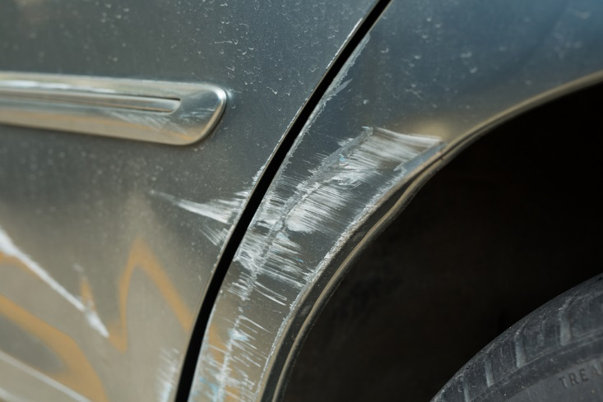
Inspect vehicle after recovery and perform maintenance/repairs before proceeding
Fixing panel damage
Noting diffs and transmission needs to be checked after immersion in water (to remove any water which may be present)
Rolling recovery cables back onto winch spools
Greasing and oiling parts
Removing physical debris
Notes:
Trainer continues to present action/checks:
Re-aligning panel damage to enable free movement of wheels and steering
Making note to have differential and transmission checked (for water) and/or serviced at nearest opportunity
Rolling cables and ropes back onto spools of winches
Greasing and oiling nominated parts
Removing visible debris – from areas and parts such as:
Winches
Winch cables
Radiator
Front of vehicle
Engine bay
Wheel arches
Suspension/under vehicle areas.
Classroom Activity – Demonstration and Practical
Trainer shows students how to perform tasks listed on the slide and gives them opportunity to practice the same.

Slide 114

Element 3 – Provide basic maintenance for a 4-WD vehicle
Performance Criteria for this Element are:
Identify minor faults
Determine cause of faults
Conduct visual inspection of and operational tests on vehicle
Effect necessary repairs
Effect necessary preventative maintenance
Notes:
Trainer identifies for trainees the Performance Criteria for this Element, as listed on the slide.
Class Activity – General Discussion
Trainer leads a general class discussion by asking questions such as:
What are examples of minor repairs?
What vehicle repairs and maintenance have you undertaken?
What types of vehicle shave you worked on? When? Where?
What is preventative maintenance?

Slide 115

Identify minor faults
Ways to identify vehicle faults:
Talk with those who have driven or been in the vehicle:
Asking questions
Listening to what they say
Getting them to indicate problems
Test driving the vehicle
(Continued)
Notes:
Trainer presents ways to identify vehicle faults:
Talking with those who have operated/driven or been in a vehicle. Actions required include:
Asking open and closed questions
Asking probing questions
Using terminology appropriate to the individual – avoiding complex terms if the person does not understand them
Listening to what is said
Getting them to point to locations of problems they have identified
The discussion should aim to:
Identify type and nature of fault
Describe the fault if it cannot be identified
Explain whereabouts it is located (if appropriate)
Describe symptoms and indicators
Give an idea of frequency of the problem
Identify conditions under which fault occurs/presents
Test driving the vehicle – to:
Attempt to induce the fault – which can often be a frustrating experience as a problem ‘on tour’ often fails to manifest itself on return
Listen to sounds made by the vehicle
Get a feel for the vehicle – and how it handles and responds
Smell any odour which may be generated by the fault
Duplicate causal conditions which were known to trigger the problem
Compare the way it is ‘now’ to how it normally behaves – in some cases a ‘fault’ with a vehicle as identified by someone else can simply be a ‘lack of performance’ which is really not a fault but simply the standard operating parameters of the vehicle.

Slide 116
Identify minor faults
Running the vehicle in a stationary position
Reading vehicle reports and logs
Notes:
Trainer continues to present ways to identify vehicle faults:
Running stationary vehicle to induce fault – which may involve:
Applying handbrake and/or chocking vehicle
Running vehicle from a cold start
Starting vehicle from a hot start
Running vehicle with nominated accessories turned ’on’ (and/or ‘off’) as required
Running vehicle for nominated period of time
Monitoring/observing vehicle from inside and/or outside of the vehicle
Reading reports which have been prepared on the vehicle – such as:
Roadworthy/unroadworthy certificates
Vehicle defect notices
Service reports
Daily (‘Start of Day’) vehicle inspection checklists
End of Tour reports
Damage reports
Maintenance requests
Usage log.

Slide 117

Determine cause of faults
In reality the process of identifying cause of faults (‘diagnosing faults’ or ‘troubleshooting’):
Is often not straight-forward
Can be very time consuming
Can be difficult in terms of replicating the problem so the fault/cause can be identified
Can be more difficult than actually fixing the problem
Notes:
Trainer provides context stating:
Identifying the cause of faults may also be known as:
‘Diagnosing’ faults
‘Troubleshooting’
In many cases the reality of this stage is:
It is not straight-forward
The process can be very time consuming
It is difficult to re-produce the fault so the cause can be found
It can be harder to determine the cause than it is to fix the fault.
Classroom Activity – Guest Speaker (or Excursion to garage)
Trainer arranges for qualified mechanic to attend and:
Explain option for fault identification
Give hints and tips for identifying faults
Demonstrate fault diagnoses.

Slide 118

Determine cause of faults
Practices for diagnosing faults:
Analysing information gained from fault identification process
Using diagnostic flowcharts
Using on-board diagnostics
(Continued)
Notes:
Trainer presents practices for diagnosing vehicle faults:
Analysing available information (‘evidence’) obtained from the fault identification process to provide a list of tests to perform in order to:
Generate/cause the fault
Test options regarding what might be causing the problem
Eliminate possible causes in a structured and sequential, one-at-a-time basis
Identify causes
Using diagnostic flowcharts – as provided by manufacturers for different parts/components of the vehicle
Using on-board diagnostics (OBD) – which require a purpose-built scanning tool to (reader) be plugged into the on-board computer to display and interpret a Diagnostic Trouble Code (DTC) which describes the fault.
Classroom Activity – Demonstration and Practical
Trainer shows students how to undertake activities listed on the slide and provides an opportunity for them to do the same.

Slide 119
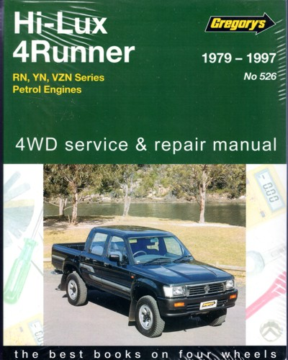
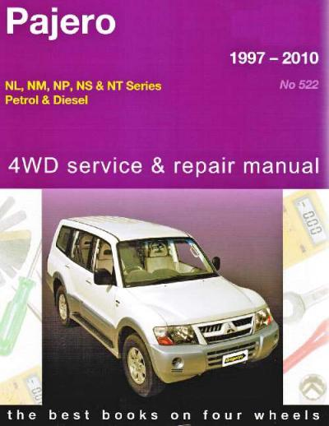
Determine cause of faults
Referring to service, owner, operator manuals
Seeking advice from vehicle manufacturer
Referring to personal experience
(Continued)
Notes:
Trainer continues to present practices for diagnosing vehicle faults:
Referring to service and operator manuals – as most minor faults can be determined with reference to these books
Seeking additional advice from the manufacturer – which may take the form of:
On-line advice – using:
Free, password protected access to contracted assistance provided as part of new vehicle purchase
Fee-for-service specialist advice
Over the phone assistance – from the manufacturer or the agent/business that sold the vehicle
In-person help – which may include:
Talking with the Service Manager at the agency
Taking the vehicle in to the business for one of the mechanics to look at and give free-of-charge advice on – this is a viable option where the organisation purchases significant vehicles from the one car dealership and/or where a ‘preferred supplier’ arrangement exists with the business
Referring to personal experience – the more experience a person has in diagnosing faults, the greater their pool of experience becomes
This personal experience generates a useful source of information as it is based on ‘legitimate’, first-hand practice.

Slide 120
Determine cause of faults
Loading vehicle onto jacks or stands
Using sensory appraisal
Monitoring on-board instrument panel
Monitoring externally-attached testing equipment
Notes:
Trainer continues to present practices for diagnosing vehicle faults:
Loading vehicle onto jacks, stands or a hydraulic lift – in order to:
Get a better look at the vehicle and be able to see ‘up and under’ it and the engine bay. Certainly, raised vehicles always make it easier to identify the location of leaks and drips
Free up certain suspension components
Make it easier to manipulate other parts of the vehicle
Using applicable sensory appraisal to help determine cause – this is similar to using the senses to help identify a fault in the first place, and can (depending on the issue) rely on:
Sight – for noting smoke emissions, loose connections and broken and missing parts
Feel – for identifying vibrations
Smell – for detecting unusual odours from the vehicle such as running rich, ‘electrical’ and rubber smells
Hearing – for perceiving exhaust (‘noise emissions’) and engine problems (‘mis-fires’, ‘racing’, ‘knocks’) when the vehicle is running
Monitoring on-board instrument panel – which can mean watching and interpreting the readings of:
Temperature gauges
Tachometers
Oil pressure
Battery charge
Monitoring externally attached equipment – such as:
Various diagnostic tools
Battery/alternator testers
Vacuum and fuel pump testers
Electronic brake service tool
Compression test
Circuit testers and multi-meters.

Slide 121
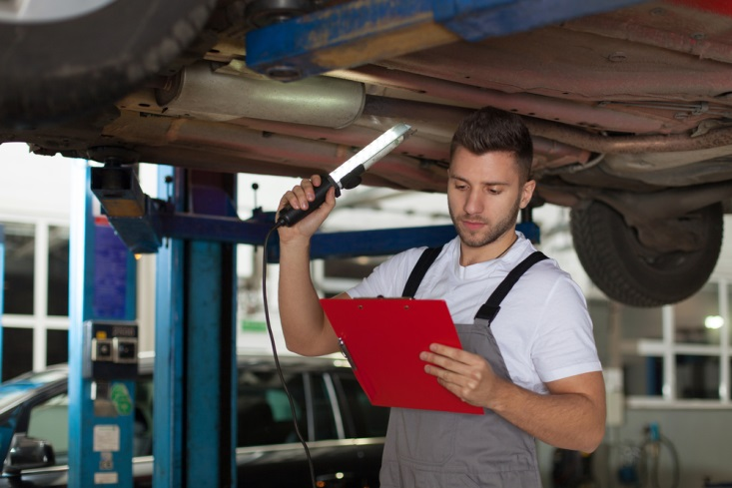
Conduct visual inspection of and operational tests on vehicle
Activities in the visual inspection process:
Look at and under the vehicle – lift the vehicle off the ground if possible
Light the areas being inspected
(Continued)
Notes:
Trainer describes activities involved in the inspection process:
Looking at and under the vehicle and closely checking all aspects of the vehicle – while it is:
On the ground, and/or
On a hoist or over an inspection pit – if a hoist or inspection pit is not available the inspection can occur by using:
Trolley jacks
Car stands
Under-vehicle car trolleys/creepers
Lighting the areas being inspected – with:
Inspection lights
Torches.
Classroom Activity – Demonstration and Practical
Trainer demonstrates and explains the vehicle inspection activities shown on the slide and provides opportunity for students to do the same.

Slide 122
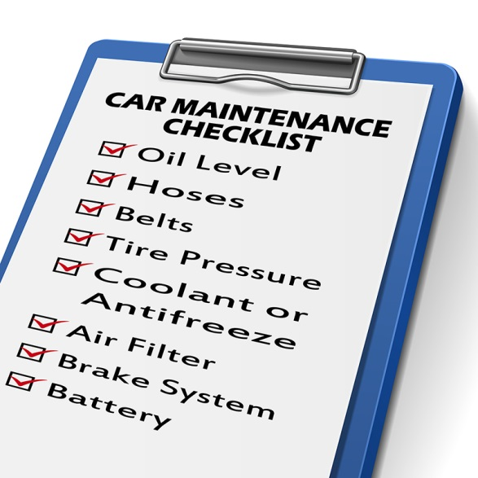
Conduct visual inspection of and operational tests on vehicle
Use a ‘Vehicle Inspection Checklist’
Inspect the vehicle in pairs
(Continued)
Notes:
Trainer continues describing activities involved in the inspection process:
Using a checklist – to:
Provide evidence the inspection occurred
Note defects and matters requiring attention
Inspecting the vehicle in pairs – so that:
Issues can be analysed/discussed
A more effective inspection takes place – that is, there is less chance something will be missed if two people do the inspection.
Classroom Activity – Handout
Trainer distributes and discusses use of sample vehicle inspection checklist.

Slide 123

Conduct visual inspection of and operational tests on vehicle
Look for signs of damage
Look for missing parts
(Continued)
Notes:
Trainer continues describing activities involved in the inspection process:
Looking for signs of damage to the vehicle – as these signs can indicate:
Where a more detailed inspection needs to occur to determine:
If the damage has caused a problem/further problem
Whether the damage is a result of another issue
Need for immediate action – to:
Fix the cause
Take temporary action to reduce/prevent further damage
Keep the vehicle on-the-road/operational
Need to take later action – which may not be immediately necessary to
Possible cause or source of the damage
What may be needed/possible to prevent recurrence
Checking for missing parts – from:
Inside the cabin
Inside the passenger area
On the exterior of the vehicle
Under the hood/bonnet.
Classroom Activity – Demonstration and Practical
Trainer demonstrates and explains the vehicle inspection activities shown on the slide and provides opportunity for students to do the same.

Slide 124

Conduct visual inspection of and operational tests on vehicle
Note leaking fluids
Identify projections from the vehicle
Take on-the-spot action to fix simple problems
Check condition of vehicle components
Check fluid levels
Notes:
Trainer continues describing activities involved in the inspection process:
Noting leaking fluids – as this can:
Identify type of fluid
Identify location of leak
Indicate severity of problem
Determine, to an extent, the type of problem needing to be addressed
Identifying projections from the vehicle – this relates to:
Body parts which have been worked loose, damaged or snagged and are hanging loose or sticking out from beyond the normal dimensions of the vehicle presenting a danger to other vehicles, people or structures
Items caught up under the vehicle or under wheel wells, around wheels and brake lines, in the engine bay or from vehicle protection bars or lighting bars
Taking immediate action to rectify problems – which can be quickly and easily fixed on-the-spot, such as:
Clearing blockages
Tightening screws, nuts, bolts and fittings
Checking the condition/appearance of critical components of the vehicle (which may involve physical touching, moving, squeezing and removing of parts) such as:
Radiator hoses
Timing belts
Fan belts
Tyres including all spares
Oil, air and fuel filters
Battery/batteries, battery leads, posts, connections, brackets and mountings
Checking fluid levels – of:
Water – radiator and battery/ies
Engine oil
Transmission fluid
Brake fluid
Power steering fluid.
Classroom Activity – Demonstration and Practical
Trainer demonstrates and explains the vehicle inspection activities shown on the slide and provides opportunity for students to do the same.

Slide 125

Conduct visual inspection of and operational tests on vehicle
Basic tests to conduct:
Operation and condition of lights
Condition and travel of vehicle pedals
Operation of parking brake
Notes:
Trainer presents basic tests to conduct:
Lights – in terms of:
Right and left indicator lights – front and rear (including trailers)l Headlights – left and right, low beam and high beam; Driving lights and fog lights – on and off; driving lights turn off when low beam selected; Parking lights – front and rear; Tail lights; Reversing lights; Brake lights; Number plate light – front and rear; Side marker lights; Hazard warning lights; Reflectors; Internal vehicle/cabin lights; Instrument lights and signals
Lights should be:
Clean and clear; Without cracks or damage; Correct colour; Firmly and correctly fitted
Condition of vehicle pedals – for example:
Checking engagement point of brake and clutch pedals
Confirming travel of pedals and freedom from blockages/interference
Activating knobs and switches and confirming they function as required
Operation of parking brake (also known as the ‘hand brake’) – to confirm:
Hand brake can be pulled on and will hold the vehicle on a nominated gradient (say, 12% gradient)
Hand brake can be easily and comfortably released to the full ‘off’ position.

Slide 126

Effect necessary repairs
To change light globe:
Identify light to be changed
Obtain correct globe (or unit)
Remove light cover
Unplug electrical connector
Remove entire unit, if necessary
(Continued)
Notes:
Trainer describes how to change light globe in vehicle:
Identify the light to be replaced
Obtain correct globe for the job – sealed units will require the entire headlamp to be replaced; semi-sealed units only require the light globe
Remove the light cover/dust cover
Unplug electrical connector
In some cases there is a need to remove the entire light assembly to replace a light globe.
Classroom Activity – Internet research
Trainer supervises internet research on relevant websites such as:
http://www.supercheapauto.com.au/how-to/Outside-the-Car/Checking-and-Changing-an-Automotive-Light-Globe.aspx?id=79 – Checking and changing an automotive light globe
https://www.youtube.com/watch?v=6hURsa46t4M – How to change a headlight bulb
https://www.youtube.com/watch?v=jk1kFc56dwk – How to replace headlight bulbs
https://www.youtube.com/watch?v=cB99QN1AYBU – How to install replace front lower side reflector
https://www.youtube.com/watch?v=mgGWFqPe0Ms – Headlight bulb replacement service: 2005 Honda CRV
https://www.youtube.com/watch?v=5F31wzh60zo – How to replace taillight
https://www.youtube.com/watch?v=9POigqpLxQc – How to replace fog light and bulb.

Slide 127
Effect necessary repairs
Disconnect globe from holder
Remove old globe noting how it sits
Insert new globe – avoid glass contact with fingers
Re-attach connectors and fittings
Test
Notes:
Trainer continues to describe how to change light globe in vehicle:
Disconnect whatever mechanism is used to keep the old globe in place
Remove the old globe noting how it sits – bayonet globes are removed by rotating them anti-clockwise
Put the new globe in position taking care not to touch the glass part of the globe with the fingers
Re-attach the mechanism, electrical connection and cover
Test the light to make sure it is working.
Classroom Activity – Demonstration and Practical
Trainer shows students how to change a variety of vehicle globes and provides an opportunity for them to do the same

Slide 128
Effect necessary repairs
To change fan belt:
Release tension on old belt at bolt on tensioner rail
Move alternator to allow free play in old belt
Remove old belt
(Continued)
Notes:
Trainer describes how to change fan belt in vehicle:
Release tension on old belt at bolt on tensioner rail
Move alternator to allow free play in old belt
Remove old belt.
Classroom Activity – Internet research
Trainer supervises internet research on relevant websites such as:
https://www.youtube.com/watch?v=4hnOUs9eiN4 – Change a fan belt
http://www.supercheapauto.com.au/how-to/Servicing-Mechanical/Replacing-a-Drive-Belt.aspx?id=76 – Replacing a drive belt
https://www.youtube.com/watch?v=Wg1AX77xEBQ – How to replace a serpentine belt
https://www.youtube.com/watch?v=01J3Fp9_bMA – How to replace a serpentine belt: Toyota Corolla
https://www.youtube.com/watch?v=XD0LNkFYPGQ – Toyota timing belt
http://www.wikihow.com/Change-an-Automotive-Belt.

Slide 129
Effect necessary repairs
Fit new belt looping it over alternator and water pump pulleys
Re-locate alternator to bring tension on the belt
Tighten bolt on tensioner rail
Run engine and adjust belt if/as required
Notes:
Trainer continues to describe how to change fan belt in vehicle:
Fit new belt by looping it over alternator and water pump pulleys
Re-locate the alternator to bring tension on the new belt
Tighten the bolt on the tensioner rail
Run the engine to test for:
Squealing noise – indicating belt is slipping and needs to be re-tensioned
Dashboard warning lights – which may indicate a problem.
Classroom Activity – Demonstration and Practical
Trainer shows students how to change a fan belt and provides an opportunity for them to do the same

Slide 130
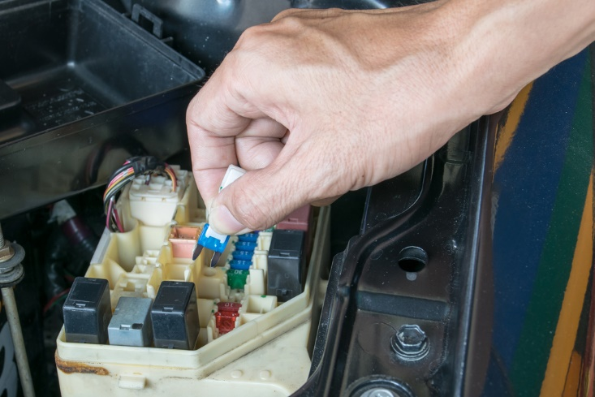
Effect necessary repairs
To change/replace a fuse:
Locate fuse box/block
Remove cover
Read key to fuses
Remove old fuse
(Continued)
Notes:
Trainer describes how to change/replace a fuse in vehicle:
Locate fuse box/block
Remove cover
Read key on cover (or in manual) to determine the fuse to replace
Remove fuse to be replaced.
Classroom Activity – Internet research
Trainer supervises internet research on relevant websites such as:
https://www.youtube.com/watch?v=kOXeo-kqg68 – How to replace a blown fuse in a car
https://www.youtube.com/watch?v=faWZmG0fXy8 – How to find and replace a blown fuse in your car or truck.

Slide 131
Effect necessary repairs
Insert new fuse
Verify spare fuses remain available for later use
Test vehicle to verify new fuse is working
Replace fuse box/block cover
Notes:
Trainer continues to describe how to change/replace a fuse in vehicle:
Insert new fuse – press in position with finger
Verify spare fuses are available for emergency use – where space provided to store them
Test vehicle/accessory/light which was operating on this fuse
If fuse blows immediately then this usually indicates another problem (a short) and the vehicle may need to be taken to an auto-electrician
If light/accessory functions as required, replace fuse box/block cover.
Classroom Activity – Demonstration and Practical
Trainer shows students how to replace a fuse and provides an opportunity for them to do the same

Slide 132
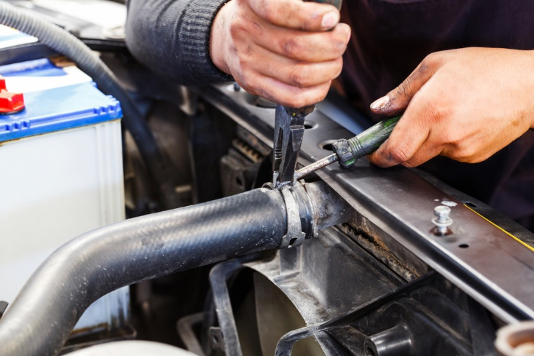
Effect necessary repairs
To change radiator hose:
Allow motor to cool – remove radiator cap
Drain radiator – by plug or removing bottom hose
Use pliers to release clamp holding hose in place
Replace thermostat at this time too?
(Continued)
Notes:
Trainer describes how to change coolant/radiator hose in vehicle:
Ensure engine has cooled before removing radiator cap
Drain radiator – if necessary, using drain plug if fitted: there may be a requirement to retain the fluid to put back in the radiator
Remove bottom radiator hose from radiator if there is no drain plug – use
Use pliers to release clamp holding hose in place – at front and back of top and bottom hose (if changing both hoses)
It may be a good time to replace the thermostat while the top hose is off the vehicle.
Classroom Activity – Internet research
Trainer supervises internet research on relevant websites such as:
https://www.youtube.com/watch?v=AGmQ50naiGg – How to replace a radiator hose (upper and lower)
https://www.youtube.com/watch?v=C64z0L9816A – Replacing radiator hose
https://www.youtube.com/watch?v=xH0D22ITjQU – How to replace the upper radiator hose.

Slide 133

Effect necessary repairs
Clean parts to which hose was clamped
Determine if new hose clamps are needed
Position clamps near end of hose
(Continued)
Notes:
Trainer continues to describe how to change coolant/radiator hose in vehicle:
Clean the parts to which the hose ends were secured – to remove visible debris
Determine if new hose clamps need to be used to fit the new hose/s – use new clamps where indicated
Position clamps (using pliers to open them up) near end of new hoses and replace hoses.

Slide 134

Effect necessary repairs
Re-attach hose to radiator tightening clamps
Fill radiator
Run and check for leaks
(Continued)
Notes:
Trainer continues to describe how to change coolant/radiator hose in vehicle:
Re-attach clamps
Fill radiator
Run and check for leaks.
Classroom Activity – Demonstration and Practical
Trainer shows students how to change a radiator hose and provides an opportunity for them to do the same

Slide 135
Effect necessary repairs
Points to note when checking/topping up radiator:
Allow engine to cool
Check on level ground
Add coolant if required
Wear protective eyewear
(Continued)
Notes:
Trainer discusses checking and topping up radiator water stating important points to note:
Engines should be cold when checking and replenishing water in the radiator to avoid safety issues associated with high temperatures and water under pressure
Check fluid levels on level ground
Many radiators require the addition of coolant to the water when replenishing radiator levels – this may be pre-mixed, or require mixing as part of the process. Always follow instructions on the product when adding/mixing coolant
Wear protective eyewear when handing coolant.

Slide 136
Effect necessary repairs
Topping-up radiator:
Remove cap from radiator or water reservoir/tank
Mix coolant and water
Add mixture observing ‘Min-Max’ levels
Replace cap/cover
Notes:
Trainer explains topping up radiator may entail:
Removing cover/cap from engine coolant/water tank or reservoir
Mixing coolant with water according to manufacturer’s recommendations (say, 50:50) if product is not pre-mixed – the preference is to use distilled water for this purpose
Adding mixed coolant to engine coolant/water tank or reservoir – observe ‘Min – Max’ marks on the tank/reservoir and do not over-fill
Replacing and securing cover/cap
In some situations it may be necessary (or even acceptable) to simply top-off the engine coolant/water tank or reservoir with tap water.
Classroom Activity (1) – Internet research
Trainer supervises internet research on relevant websites such as:
https://www.youtube.com/watch?v=vEdtHZwLKZ8 – Basic car care and maintenance: checking car radiator coolant level
Classroom Activity (2) – Demonstration and Practical
Trainer shows students how to top-up radiator and provides opportunity for them to do the same.

Slide 137
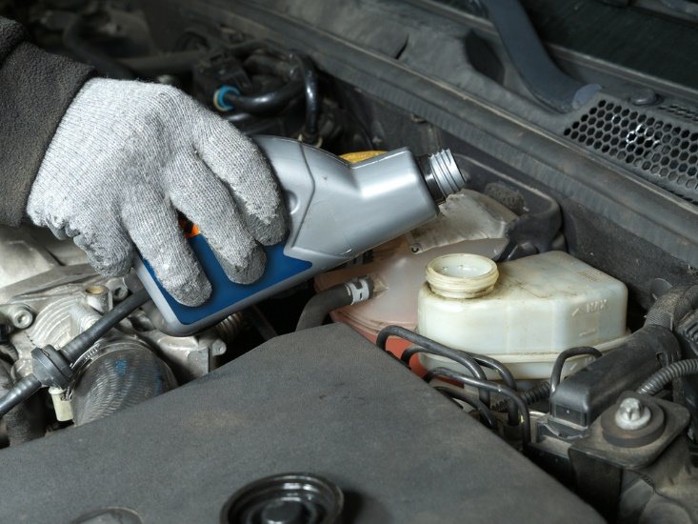
Effect necessary repairs
To top-up brake fluid:
Wear protective gloves and eyewear
Identify level of brake fluid in brake fluid reservoir
Clean top and around cap of brake fluid reservoir before removing it
(Continued)
Notes:
Trainer explains topping up brake fluid may entail:
Wear protective eyewear and gloves
Identify the level of the brake fluid in the brake fluid reservoir – top-up when level is below the ‘Min’ mark
Clean the top of, and around, the cap of the brake fluid reservoir prior to opening the unit – to make sure no debris falls in.
Classroom Activity – Internet research
Trainer supervises internet research on relevant websites such as:
https://www.youtube.com/watch?v=LZ8BZa7d0CQ – How to check and top-up brake fluid: Nulon
https://www.youtube.com/watch?v=nJV0J9kTZ2g – Top up your car’s brake fluid.

Slide 138
Effect necessary repairs
Pour brake fluid directly into brake fluid reservoir
Fill only to ‘Max’ line
Replace and secure cap of brake fluid reservoir
Wipe away any spills
Notes:
Trainer continues to explain topping up brake fluid may entail:
Pour brake fluid direct from container into the brake fluid reservoir – take care not to spill, and use fresh product where possible
Fill only to ‘Max’ line/level on the brake fluid reservoir – do not over-fill
Replace and secure the cap of the brake fluid reservoir
Wipe away any spills.
Classroom Activity – Demonstration and Practical
Trainer shows students how to top-up brake fluid and provides opportunity for them to do the same.

Slide 139
Effect necessary repairs
Points to note when checking auto transmission fluid:
Wear protective eyewear
Park on flat ground
Make sure engine is at operating temperature
Check to see if engine needs to be running or not
Notes:
Trainer discusses checking automatic transmission fluid noting:
Wear protective eyewear when handing transmission fluid
Park on flat/level ground
Make sure engine is at operating temperature when checking the fluid – not cold
Some makes and models may need to be checked when engine is running and some do not need the engine to be running – follow requirements in Owner Manual.

Slide 140

Effect necessary repairs
Topping-up automatic transmission fluid:
Locate correct dipstick
Remove dipstick
Wipe dipstick clean
Re-insert dipstick
Remove dipstick
(Continued)
Notes:
Trainer describes topping-up automatic transmission fluid:
Locate the dipstick for the transmission fluid in the engine bay – ensure the dipstick is not the one for the engine oil
Remove the dipstick
Wipe clean with paper towel or clean rag
Re-insert dipstick – to get reading
Remove dipstick.

Slide 141

Effect necessary repairs
Read level on dipstick
Top-up as required (small amounts) using funnel
Check level after each filling – avoid over-filling
Wipe up spills
Replace and secure dipstick
Notes:
Trainer continues to describe topping-up automatic transmission fluid:
Read level of fluid on the dipstick – if level is below ‘Min’ it needs to be topped-up
Top-up by inserting funnel into dipstick hole and pouring fluid slowly into funnel – base amount added on reading from dipstick but add small amounts
Re-check level after each addition – avoid over-filling
Wipe up any spills
Replace and secure dipstick when ‘Normal’ level is attained.
Classroom Activity – Demonstration and Practical
Trainer shows students how to top-up automatic transmission fluid and provides opportunity for them to do the same

Slide 142
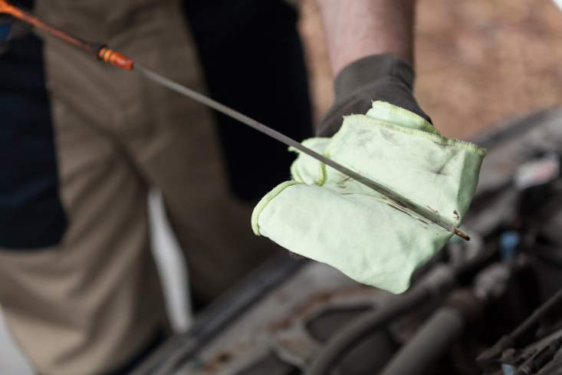
Effect necessary repairs
To check and top-up engine oil:
Park on level ground
Check oil with engine ‘off’ and cold
Locate dipstick
Remove dipstick
(Continued)
Notes:
Trainer describes checking and topping-up engine oil:
Park on flat/level ground
Check the engine oil with motor turned off and cold – do not check when engine is running and/or when it is hot
Locate the dipstick for the engine oil in the engine bay
Remove the dipstick.
Classroom Activity – Internet research
Trainer supervises internet research on relevant websites such as:
https://www.youtube.com/watch?v=6IQBZm8DBAw – Checking and adding oil to your vehicle for beginners
http://m.supercheapauto.com.au/How-To/Oils-Lubricants/Checking-Topping-Up-Engine-Oil/194 - Checking and topping up engine oil

Slide 143

Effect necessary repairs
Wipe dipstick clean
Re-insert dipstick
Remove dipstick
Read dipstick
Locate and clean around filler cover
(Continued)
Notes:
Trainer continues to describe checking and topping-up engine oil:
Wipe clean with paper towel or clean rag
Re-insert dipstick – to get reading
Remove dipstick
Read level of oil on the dipstick – if level is below ‘Min’ it needs to be topped-up
Locate oil filler cap on top of motor – clean around the cap before removing it.
Classroom Activity – Internet research
Trainer supervises internet research on relevant websites such as:
https://www.youtube.com/watch?v=uvUPsk2bN0A – Check your fluids, engine oil, transmission fluid, power steering, coolant etc …
https://www.youtube.com/watch?v=BSlouL8Ekgw – How to check car fluids, belts and perform full underhood inspection

Slide 144

Effect necessary repairs
Use funnel to pour oil into engine
Add small amounts each time
Only use oil recommended by manufacturer
(Continued)
Notes:
Trainer continues to describe checking and topping-up engine oil:
Top-up oil by inserting funnel into hole and pouring fluid slowly into funnel – base amount added on reading from dipstick
Add small amounts each time
Only use oil recommended by vehicle manufacturer.

Slide 145
Effect necessary repairs
Check level after each addition
Avoid over-filling
Clean spills
Replace and secure dipstick
Notes:
Trainer continues to describe checking and topping-up engine oil:
Re-check level after each addition
Do not overfill
Clean away any spills/drips
Replace and secure dipstick and oil filler cap when required level is attained – between ‘Min’ and ‘Max’ indicators on the dipstick.
Classroom Activity – Demonstration and Practical
Trainer shows students how to top-up engine oil and provides opportunity for them to do the same

Slide 146
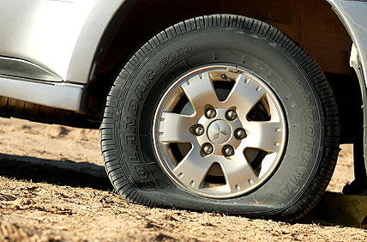
Effect necessary repairs
SOP if a tour vehicle gets a puncture:
Remove and replace with spare
Call in to a repair centre to have puncture repaired
Do not repair tyre with damaged sidewall
Do not undertake own repair of puncture unless it is necessary to do so
Notes:
Trainer discusses addressing punctures to a tour vehicle stating if a tour vehicle suffers a puncture while on tour the standard responses are to:
Remove the punctured tyre and replace with one of the spares carried on the vehicle
Call in to a repair centre, tyre agency or garage as soon as possible to have the punctured tyre repaired
Never try to repair a tyre where the sidewall is damaged
The standard response to a puncture is, therefore, not to repair the puncture until it becomes absolutely necessary to do so.

Slide 147
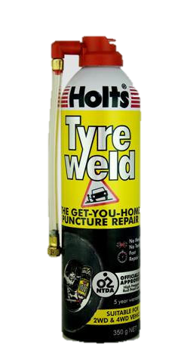
Effect necessary repairs
Options for repairing punctures:
Use a pressurised can of tyre adhesive
Use a tyre repair kit to plug the hole
Notes:
Trainer identifies and explains two options for puncture repair:
Use a pressurised commercial can of tyre adhesive to provide a short-term solution:
Following the instructions on the can
Reducing driving speed until a professional repair can be made
Getting the tyre repaired professionally at the earliest opportunity
Use a tyre repair kit to plug the hole following the instructions which come with the kit – for example:
Remove the cause of the puncture
Lubricate reaming tool and ream out hole with the tool in the kit – to make the hole big enough to take a the plug
Lubricate the plug with some rubber adhesive – and fix into the insertion tool
Use the insertion tool to locate the plug into the hole- - and withdraw the insertion tool
Cut off excess plug protruding from the tread of the tyre
Inflate the tyre as required.
Classroom Activity (1) – Internet research
Trainer supervises internet research on relevant websites such as:
https://www.youtube.com/watch?v=ulQmDaqv4F4 – Best tire repair video
https://www.youtube.com/watch?v=LRQJgTxRhOA – How to repair a puncture in a tyre with a repair plug/string
http://www.toughtoys.com.au/4wd-recovery/tyre-repair-kits-and-equipment/ - Tyre repair kits and equipment.
Classroom Activity (2) – Demonstration and Practical
Trainer shows students how to plug a hole in a tyre using a tyre plug kit and provides opportunity for them to do the same.

Slide 148
Effect necessary repairs
Bleeding brakes:
May need to occur if they become soft/spongy
Can be a two-person job
All four wheels have to be bled
Brake fluid is corrosive
Notes:
Trainer discusses bleeding brakes observing:
If brakes become spongy, soft or ineffective on tour they may require bleeding to remove air in the brake lines
This can be a two-person job – one person sitting in the vehicle and pumping the brake pedal and the other handling the brake bleeder bottle and the spanner to open and close the bleeder nipple/valve
When bleeding the brakes, all four wheels have to be bled: common practice is to start the process at the wheel furthest from the master cylinder and work through all four wheels finishing with the wheel closest to the master cylinder
As brake fluid is corrosive this means it is dangerous so appropriate protective gloves and eyewear should be used.
Classroom Activity – Internet research
Trainer supervises internet research on relevant websites such as:
https://www.youtube.com/watch?v=lPwM2vn3bT0 – How to bleed disc brakes
https://www.youtube.com/watch?v=lkd7iq-dIQ0 – Bleeding the brake system.

Slide 149
Effect necessary repairs
To bleed the brakes:
Check brake fluid reservoir to ensure sufficient fluid
Monitor fluid level throughout procedure
Have replacement fluid on hand
Jack the vehicle up and remove wheels (optional)
Attach brake bleeder bottle to brake nipple
(Continued)
Notes:
Trainer describes how to bleed the brakes:
Check the brake fluid reservoir – to make sure there is sufficient brake fluid available in the reservoir before starting the process
Make sure the level is monitored throughout the process so air is not re-introduced into the brake system
Have replacement/new brake fluid on hand – to top-up the reservoir as required
Jack the vehicle up and remove the wheels – optional in some cases
Attach brake bleeder bottle to brake nipple.

Slide 150
Effect necessary repairs
Open valve and depress brake 4 – 5 times
Close valve and tighten – top up brake fluid reservoir
Check for leaks by pressing brake pedal hard
Remove bleeder bottle – discard fluid
Repeat for other 3 wheels
Notes:
Trainer continues to describe how to bleed the brakes:
Open valve and depress brake pedal four to five times
Close valve and tighten – top up reservoir with brake fluid
Check for leaks by pressing brake pedal hard – re-tighten valve/nipple if there is a leak
Remove brake bleeder bottle – discard fluid
Repeat for remaining three wheels – monitoring level of brake fluid in brake fluid reservoir and topping-up as necessary.
Classroom Activity – Demonstration and Practical
Trainer shows students how to bleed the brakes and provides opportunity for them to do the same.

Slide 151
Effect necessary repairs
Bleeding a diesel engine:
Refers to removing air from the fuel lines
Air locks will prevent the engine starting or running smoothly
Always follow directions in Owner manual
Modern vehicles may feature easy-to-use ‘bleed screws’
Notes:
Trainer discusses bleeding an engine stating:
Bleeding a diesel engine refers to removing air from the lines so the engine will re-start after, for example, the engine has run out of fuel or there has been a need to replace the fuel filter
If the engine/fuel lines are not bled, the air in the lines blocks the flow of fuel and the engine will not start (or will run roughly)
Refer to the Owner’s manual/Operator’s manual for the vehicle to obtain manufacturer’s instructions in this regard as there are different requirements and vehicle components for different makes and models of vehicles and engines
More modern engines feature alternate (more simple-to-use) systems such as bleed screws whereby the screw is opened, the engine is cranked and then the screw is closed.

Slide 152
Effect necessary repairs
To bleed an engine:
Fill with fuel
Confirm new fuel filter is correctly fitted
Prime the lift pump
Open line to injector furthest from pump and allow air to escape
Tighten line when steady flow of diesel appears
Clean up spilled fuel
Repeat for each cylinder
Notes:
Trainer describes actions to bleed an engine:
Filling the vehicle with fuel – to prevent recurrence of the problem if the problem was caused by running out of fuel
Confirming the new fuel filter is properly fitted – and was filled with fuel prior to being re-fitted
Prime the lift pump – by activating the level attached to move fuel to the injector
Open the line to the injector furthest away from the pump – and allow air to escape
Tighten the line when there is a steady flow of diesel – and clean away spilt fuel
Repeat for each cylinder.
Classroom Activity – Demonstration and Practical
Trainer shows students how to bleed an engine and provides opportunity for them to do the same.

Slide 153
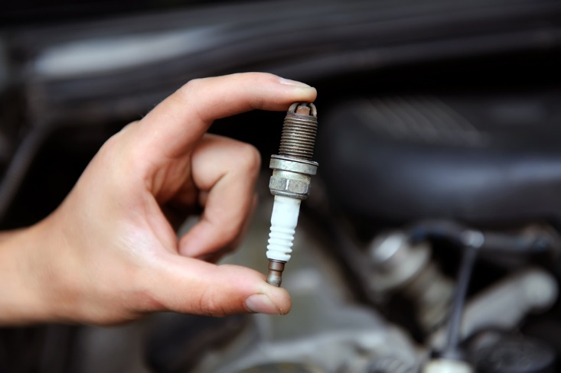
Effect necessary repairs
To change spark plugs:
Disconnect HT lead to plug
Loosen plug with spark plug socket
Use fingers to remove spark plug
Take care to not let debris fall into cylinder
(Continued)
Notes:
Trainer describes process for replacing spark plugs:
Disconnect the HT lead to the spark plug
Use a spark plug socket attached to a wrench in an anti-clockwise direction to loosen the used spark plug – many plugs can be hard to shift so a long handle will provide the necessary extra pressure
Use the fingers to unscrew the old spark plug and remove it once it has been freed
Take care not to allow any debris to fall into the cylinder.

Slide 154
Effect necessary repairs
Clean or obtain new plug
Use feeler gauge to set correct gap
Use fingers to re-seat plug into block
(Continued)
Notes:
Trainer continues to describe process for replacing spark plugs:
Clean the plug with a wire brush and check the condition of the plug to determine:
If a new plug is required
If there is evidence of another problem which should be investigated
Use a feeler gauge to set the correct gap for the old or new spark plug to be fitted
Use fingers to re-seat the plug into the block.
Classroom Activity – Internet research
Trainer supervises internet research on relevant websites such as:
http://www.supercheapauto.com.au/how-to/Servicing-Mechanical/Replacing-Spark-Plugs.aspx?id=68 – Replacing spark plugs
https://www.youtube.com/watch?v=jj06A6UdHvI – Changing spark plugs and replacing plug wires.

Slide 155
Effect necessary repairs
Tighten finger tight
Secure with socket to torque specification
Re-attach HT lead
Start and run engine to test
Notes:
Trainer continues to describe process for replacing spark plugs:
Tighten gently until finger tight and ensure thread is not crossed
Finish tightening with spark plug socket attached to a torque wrench to required torque specification
Re-attach HT lead
Start and run motor to test.
Classroom Activity – Demonstration and Practical
Trainer shows students how to change spark plugs and provides opportunity for them to do the same.

Slide 156
Effect necessary repairs
To replace glow plugs:
Remove visible debris around plugs
Disconnect battery
Use spanner to remove nuts holding bridging strap to plugs
Remove bridging strap
(Continued)
Notes:
Trainer describes process for replacing glow plugs:
Remove any visible debris around the plugs which may fall into the cylinders – use of compressed air is recommended
Disconnect the (negative) battery terminal
Use a spanner to remove the nuts holding the bridging strap to the plugs
Remove the bridging strap.
Classroom Activity – Internet research
Trainer supervises internet research on relevant websites such as:
https://www.youtube.com/watch?v=4Po_1pNHE1Y – Easy and complete glow plug test.
http://autorepair.about.com/od/enginerelateddiyjobs/l/aa081404a.htm - How to replace your diesel glow plugs.

Slide 157
Effect necessary repairs
Use spanner to loosen plugs and remove with fingers
Test new plug to be fitted
Ensure plug and thread is clean
Screw new plug in by hand until seated in cylinder head
(Continued)
Notes:
Trainer continues to describe process for replacing glow plugs:
Use a spanner to untighten the glow plug and remove with fingers
Test the new glow plug to be fitted
Ensure plug and thread is clean
Screw new plug in by hand until seated in cylinder head.
Classroom Activity – Internet research
Trainer supervises internet research on relevant websites such as:
https://www.youtube.com/watch?v=RCcmN-r5Z9M – Replacing glow plugs in a Mitsubishi Delica L400
https://www.youtube.com/watch?v=4Po_1pNHE1Y – Glow plug change

Slide 158
Effect necessary repairs
Tighten with torque wrench to required specification
Replace bridging strap and nuts
Re-connect battery
Test
Notes:
Trainer continues to describe process for replacing glow plugs:
Tighten with torque wrench to torque specification according to the individual plug
Replace bridging strap securing with nuts
Re-connect battery
Test.
Classroom Activity – Demonstration and Practical
Trainer shows students how to change glow plugs and provides opportunity for them to do the same.

Slide 159
Effect necessary preventative maintenance
Provision of regular service and maintenance to tour vehicles will/can:
Help extend working life of the vehicle
Increase reliability of the vehicle
Reduce operating costs
Present a better-looking vehicle to tour groups
Notes:
Trainer highlights provision of regular service and maintenance to tour vehicles will/can:
Help extend working life of the vehicle
Increase reliability of the vehicle
Reduce operating costs
Present a better-looking vehicle to tour groups – which increases confidence in the tour staff and tour operator.

Slide 160
Effect necessary preventative maintenance
Ways to determine preventative maintenance requirements:
Take into account distance travelled and hours vehicle has been used
Conduct and note response to pre-start checks
Comply with internal organisational SOPs
(Continued)
Notes:
Trainer presents ways to determine preventative maintenance requirements:
Take into account distance travelled and number of hours the vehicle has been used – there is a direct relationship between extensive/long use’ and the need to provide preventative maintenance
Conduct and note response to pre-start checks – as designated by vehicle manufacturers specific to individual makes and models of 4WDs which may indicate need for maintenance. These checks commonly involving checks of:
Fuel, water and oil; Brake and transmission fluid levels; Battery water levels and electrolyte checks; Tyres; Belts; Leads; Hydraulic lines and connections; Air cleaners; Air-conditioners; Brakes
Comply with internal organisational SOPs – many Tour Operators will provide a ‘Start of day’ checklist for each tour vehicle which needs to be followed before the vehicle is used every day. These lists:
Differ between vehicle types to reflect their individual need
Provide a record of the inspection to prove the check was undertaken as required
Record work done as part of the daily inspection
Note where items may require further attention at a later stage/at conclusion of the tour.

Slide 161
Effect necessary preventative maintenance
Factor in the nature of roads/tracks travelled
Use personal observation
Refer to personal experience
Research/read manufacturer requirements
Notes:
Trainer continues to present ways to determine preventative maintenance requirements:
Factor in the nature of roads/tracks travelled – some surfaces are more punishing than others and will impose a more urgent need for attention to the vehicle
Surfaces where there has been lots of sand, rocks, water crossings and/or mud are all indicators for some extra inspection/maintenance
Use personal observation – in terms of:
The way the vehicle is performing/responding
Sensory awareness of changes in noises, vibration and/or smells from the vehicle
Noticing damaged items on the vehicle
Noting alerts from on-board warning lights or instruments,
Refer to personal experience – related to previous incidents which have been experienced with similar vehicles under similar conditions
Research/read manufacturer requirements in relation to routine servicing and preventative maintenance – in:
Service manuals
Owner manuals
Repair manuals.

Slide 162
Effect necessary preventative maintenance
Examples of preventative maintenance which may be required for on-tour vehicles:
Cleaning
Undertaking scheduled service tasks as recommended by the manufacturer
(Continued)
Notes:
Trainer indicates possible preventative maintenance required for on-tour vehicles:
Cleaning the vehicle – the value of cleaning on tour must never be under-estimated. Cleaning in this context involves:
Removing dirt, sand, mud and grit and grime; Cleaning the engine bay; Cleaning out under the wheel arches; Cleaning the winch; Cleaning lights and reflectors; Cleaning the windscreen and windows
Undertaking scheduled service tasks as recommended by the manufacturer – tour vehicles will generally be fully serviced prior to departing on tours but there is always the potential for ‘scheduled servicing’ to have to be provided while on tour
There may be a preference for this service to be undertaken along the route at a qualified service provider but this is not always possible
Where it is not possible, the requirements of the Owner’s manual for the specific time period/distance travelled need to be accommodated to the best extent possible
Indicative tasks include:
Replacing belts; Replacing plugs; Draining and replacing fluids and oils; Replacing filters.

Slide 163
Effect necessary preventative maintenance
Undertaking specified tasks as nominated by Tour Operator
Replacing specific component parts
Examining tyres
(Continued)
Notes:
Trainer continues to indicate possible preventative maintenance required for on-tour vehicles:
Undertaking specified additional service tasks as required by the host enterprise – these can be prescribed by the Tour Operator on the basis of previous experience with vehicles and routes. Normally these will require:
The same attention being paid to the same parts as for a scheduled service but with greater frequency
Attention to specific parts of the vehicle as a result of activities undertaken
Replacing specific component parts – according to a nominated schedule
Examining the tyres – and checking and/or adjusting the tyre pressures.
Classroom Activity – Internet research
Trainer supervises internet research on relevant websites such as:
http://www.offroadaussie.com/2013/02/4wd-tips-and-tricks-water-crossings/ - 4WD tricks and tips: water crossing.

Slide 164

Effect necessary preventative maintenance
Topping-up fluids
Tightening loose connections and fittings
Replacing damaged/worn parts
Notes:
Trainer continues to indicate possible preventative maintenance required for on-tour vehicles:
Topping up of fluids – as required based on inspection
Tightening loose connections and fittings
Replacing damaged or worn parts.
Classroom Activity – Excursion
Trainer arranges visit to local Tour Operator to:
Talk to operators regarding operation and maintenance of 4WD vehicles for use on tours
View preventative maintenance being delivered to tour vehicles
Obtain supporting documentation relating to operation and maintenance of tour 4WD vehicles.

Slide 165
Effect necessary preventative maintenance
Most tour vehicles need to be prepared in advance of tours – as:
Dictated by Tour Operator SOPs
Determined by driver/tour crew – with reference to known itinerary
Notes:
Trainer indicates there may be a need to prepare tour vehicles in advance for known or anticipated conditions such as water and sand noting the required preparations may be:
Dictated by Tour Operator SOPs – as developed/provided by the tour organisation
Determined by the tour crew/vehicle driver – based on the knowledge, experience and expertise.

Slide 166
Element 4 – Report on 4-wheel drive operation
Performance Criteria for this Element are:
Complete documentation to record services and repair undertaken
Notify management of issues that require external attention
Notes:
Trainer identifies for trainees the Performance Criteria for this Element, as listed on the slide.
Class Activity – General Discussion
Trainer leads a general class discussion by asking questions such as:
What documentation has to be completed?
Who completes it?
When and where?
Why does it need to be completed?

Slide 167
Complete documentation to record services and repair undertaken
Reasons documentation needs to be completed:
Provide proof of daily vehicle inspections
Give a reference point for work performed
Allow accurate/comprehensive vehicle records to be kept
Enable accurate costings
(Continued)
Notes:
Trainer discusses need for Tour Operators to have documentation completed to record services and repairs undertaken to tour vehicles when on-tour:
Provide proof of inspections performed on vehicles while on tour
Give a reference point for work which has to be performed on tour vehicles
Allow comprehensive and accurate operational records to be maintained for each vehicle
Enable accurate costing to be undertaken relating to the cost of operation of individual vehicles and types of vehicles.

Slide 168
Complete documentation to record services and repair undertaken
Supply service history when vehicle is sold
Help determine future repairs/services
Demonstrate compliance with service requirements
Allow reconciliation of receipts, invoices and related paperwork
Notes:
Trainer continues to identify need to complete documentation:
Supply a database of information which can be provided to buyers when the tour vehicle is on-sold at the end of its useful life – to assist with proving regular maintenance and optimise re-sale value
Help determine future repairs and maintenance which need to be provided to individual vehicles – based on the work they have done, and any service/maintenance performed on them
Demonstrate tour crew/vehicle drivers’ compliance with internal requirements – regarding daily inspections and scheduled/required maintenance and service
Allow administration/management of the Tour Operator to reconcile receipts and invoices from external providers for vehicle expenses.

Slide 169
Complete documentation to record services and repair undertaken
A wallet or folder:
Is usually provided in each vehicle for holding relevant documents
May also contain the fuel card for the vehicle
Notes:
Trainer explains:
A wallet of folder is usually provided in all vehicles for the purposes of storing required documentation to facilitate the submission and processing of paperwork at the end of the tour
This may contain the fuel card for the vehicle.

Slide 170
Complete documentation to record services and repair undertaken
Keys when documenting services and repairs:
Write clearly
Be honest
Cover all work done
Use recognised abbreviations and acronyms
Complete documentation ‘at the time’ work is done
Notes:
Trainer highlights keys in the documentation process are:
Write clearly
Be honest
Cover all work done – be comprehensive
Use only recognised abbreviations and acronyms
Complete required documentation ‘at the time’ – as opposed to relying on memory to complete it at a later time.

Slide 171
Complete documentation to record services and repair undertaken
Daily Vehicle Inspection Checklist – is completed at start of each day for each on-tour vehicle and is used to:
Record the inspection and prove it took place
Record work done as part of the check
Note items which require further/later attention
Notes:
Trainer discusses Daily Vehicle Inspection Checklists stating:
These are the ‘Start of Day’ lists to be completed for each vehicle on every day of the tour before the vehicle is used. The checklist is used to:
Provide a record of the inspection to prove the check was undertaken as required
Record work done (service, repairs and maintenance) as part of the daily inspection
Note where items may require further attention at a later stage/at conclusion of the tour.
Classroom Activity – Handout
Trainer distributes and discusses sample Daily Vehicle Inspection Checklist.

Slide 172
Complete documentation to record services and repair undertaken
Activities in completing a Daily Vehicle Inspection Checklist:
A ‘walk around’ of the vehicle
Physical inspection of the vehicle
Starting engine and running the vehicle
(Continued)
Notes:
Trainer explains activities inherent in completing a Daily Vehicle Inspection Checklist:
A walk-around of the vehicle
Physical inspection of the vehicle
Starting of the engine and running the vehicle.

Slide 173
Complete documentation to record services and repair undertaken
Monitoring gauges/instrument panel
Checking leads and connections
Testing operation of systems and equipment
Notes:
Trainer continues to identify activities involved in completing a Daily Vehicle Inspection Checklist:
Monitoring gauges/instruments
Checking leads and connections
Testing the operation of certain systems and/or items of equipment.
Classroom Activity – Demonstration and Practical
Trainer shows students how to complete a Daily Vehicle Inspection Checklist and provides opportunity for them to do the same.

Slide 174
Complete documentation to record services and repair undertaken
Vehicle Log/Vehicle Usage Log:
Records basic details of vehicle use on a daily basis
Usually has to be completed:
At start of day
At end of day
Notes:
Trainer explains:
The Vehicle Log/Vehicle Usage Log records basic travel information for each vehicle on a day-by-day basis
It commonly has to be filled in:
At the start of the day
At the end of the day.
Classroom Activity – Handout
Trainer distributes and discusses sample Vehicle Log/Vehicle Usage Log .

Slide 175
Complete documentation to record services and repair undertaken
Information required in Vehicle Log/Vehicle Usage Log:
Name of tour
Vehicle details/identification
Odometer reading – start and end of day
Distance travelled
(Continued)
Notes:
Trainer describes information required when completing a Vehicle Log/Vehicle Usage Log:
Name/title of tour
Details of vehicle – usually by registration number, make and model
Odometer reading/s – start and end of day
Distance travelled – calculated from odometer readings.

Slide 176
Complete documentation to record services and repair undertaken
Date/s
Destination/s and route/s
Driver name and signature
Travel time/s
Notes:
Trainer continues to describe information required when completing a Vehicle Log/Vehicle Usage Log:
Date/s
Destinations and/or route taken – listing towns/locations: some Tour Operators may require odometer readings between nominated locations/destinations
Name of driver/s – and signature
Time/s – for travel (start and finish).
Classroom Activity – Demonstration and Practical
Trainer shows students how to complete a Vehicle Log/Vehicle Usage Log and provides opportunity for them to do the same.

Slide 177
Complete documentation to record services and repair undertaken
Receipts and invoices:
Need to be kept and forwarded at end of tour
Show services provided by third party providers – such as repairs, maintenance, service
Identify items supplied by third party providers – such as fuel, oil, tyres
Notes:
Trainer notes where money is spent on the tour vehicle during the tour for service the documentation supplied by the third party provider must be maintained for later reconciliation highlighting these documents (may) include quotations, receipts, service reports and invoices and they can relate to:
Work performed on the vehicle while on tour – such as repairs, service and maintenance
Vehicle-related purchases/consumables – such as fuel, oil, tyres.

Slide 178
Notify management of issues that require external attention
Reasons to report issues requiring attention – so management can:
Decide if they want to have the matter attended to or not
Obtain quotations
Make sure work to be done is best/most efficiently integrated into known tour schedule
(Continued)
Notes:
Trainer states it is important to advise management of all vehicle issues which require future attention by an external service provider so as they can:
Decide if they want to have the matter attended to or not – in some cases they may make an intentional decision not to fix an identified problem
Obtain quotations – for work which has to be done so the best/most competitive price is obtained
Make sure the work to be done is best/most efficiently integrated into the known tour schedule – of the business.

Slide 179
Notify management of issues that require external attention
Make arrangements for a replacement vehicle
Ensure all tour vehicles are maintained in a safe and reliable condition
Factor this knowledge into other tour-related planning decisions
Notes:
Trainer continues to identify reasons why matters needing external attention need to be communicated to management – so they can:
Make arrangements for a replacement vehicle – where necessary
Ensure all tour vehicles are maintained in a safe and reliable condition – to discharge Duty of Care responsibilities and avoid preventable break-downs and delays
Factor this knowledge into other tour-related planning decisions – such as, for example:
Decisions about whether or not to increase tour price based on increased vehicle-related costs
Decisions about whether or not to change routes and/or destinations because of damage caused to vehicles
Provision of increased or different training for drivers – such as driver training or mechanical training.

Slide 180
Notify management of issues that require external attention
Communication to management while on-tour of tour vehicle issues which will require external attention usually relate to:
Major repairs
Significant other work/expenses
Notes:
Trainer advises on-tour notification of issues requiring external attention usually relates to:
Major repairs (which are usually defined in monetary terms, such as ‘work in excess of X value) – must be notified prior to getting work done so that:
Authorisation to proceed can be obtained – because the Tour Operator may elect not to proceed with repairs
Arrangements for payment can be made – between the Tour Operator and the service provider
Significant other work/expenses which have been incurred need to be communicated on the day they were incurred – as part of the standard daily check in/tour report that the Tour Leader may be required to make, so the Tour Operator is kept informed of issues and progress.

Slide 181
Notify management of issues that require external attention
On-tour notification may occur:
Via two-way radio
Using cell phone
Via a mobile device
Notes:
Trainer advises on-tour notification/reports may be made:
Via two-way radio
Using cell phone
Via a mobile device.

Slide 182
Notify management of issues that require external attention
Report/notification may also occur at end of tour:
By providing a verbal report
By completing a vehicle maintenance requisition
By discussing the problem/issue with specialist
Notes:
Trainer advises notification may also occur when the tour concludes and there can be a need for the vehicle driver to:
Provide a comprehensive verbal report on relevant issues – as part of the Tour de-briefing/end-of-tour report, supplemented by and with reference to relevant documentation (if any) from service providers gathered throughout the tour
Complete a vehicle maintenance requisition – specifying:
Identification of vehicle to be maintained
Nature of the problem
Cause of the problem, if known
Work already done
Suggestions for maintenance made by professional third party providers en route
Discussing the problem with specialists – which is best done:
Face-to-face
While the vehicle is present – so specific points/parts can be indicated and problems replicated in front of mechanics/service providers.

